Slide 2
Iliotibial Band Syndrome: Neuromechanics in Female Runners
Eric Foch, Ph.D.

Slide 3
My Path To Ellensburg
Education
B.S. Exercise Science, U. Northern Colorado
M.S. Motor Control & Biomechanics, U. Illinois at Chicago
Ph.D. Biomechanics, U. Tennessee
Post-doctoral fellowship in PT Department, at Boston U.

Slide 4
Overuse Running Injuries
32 million Americans run (US Bureau of Labor Statistics, 2009. Table no 1249.)
Approximately 51-85 % of runners experience injury over 6 to 20 month periods (Bovens et al., 1989 Int J Sports Med; 10:S86-90; Lun et al., 2004. Br J Sports Med;38:576-80)
Knee is the most commonly injured location (Tauton et al., 2002. Br J Sports Med;36:95-101.)
No reduction in injury rate over past 30 years
(Daoud et al., 2012. Med Sci Sports Exer; 44:1325-34)
Overuse running injuries are multifactorial
Intrinsic factors and extrinsic factors

Slide 5
Tope 5 Most Common Overuse Running Injuries
Injury | Men (n) | Women (n) | Total (n)
1. Patellofemoral Pain Syndrome | 124 | 207 | 331
2. Iliotibial Band Syndrome | 63 | 105 | 168
3. Plantar Fasciitis | 85 | 73 | 158
4. Meniscal Injuries | 69 | 31 | 100
5. Tibial Stress Syndrome | 43 | 56 | 100
Tauton et al., 2004. Br J Sports Med;38:576-80.
Notes:
Doctors recording patients diagnosis in a sports medicine clinic over two years in BC

Slide 6
Gender Differences In Running
Women exhibited larger peak hip adduction and hip internal rotation angles during the stance phase of running compared to men (Ferber et al., 2003. Clin Biomech; 18:350-57.)
Women exhibited larger peak knee abduction angles during the stance phase of running compared to men
Relevance
Understanding gender differences may provide insight into the etiology of different injury patterns observed
Notes:
Looking at the stance phase

Slide 7
Determining Intrinsic Biomechanical Variables
Collect 3-D marker trajectories, electromyograms (EMG), and ground reaction force data during running
Infer how movement patterns affect soft tissue

Slide 8
Iliotibial Band Syndrome (ITBS)
Theories for ITBS
Repetitive sagittal plane knee motion
Friction (Renne, J.W., 1975. J Bone Joint Surg;57:1110-11.)
Excessive frontal plane hip and transverse plane knee motion
Compression (Fairclough et al., 2006. J Ana; 208, 309-16.)

Slide 9
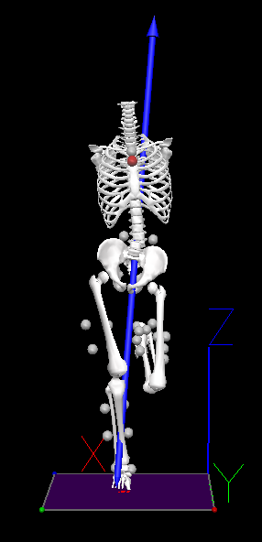
ITBS Literature: 2007-2011
Women who later develop ITBS and with previous ITBS
Greater hip adduction angle (θ) (Noehren et al., 2007. Clin Biomech;22:951-56; Ferber et al., 2010. J Ortho Sports Phy Ther;40:52-58)
Runners with current ITBS
Exhibit decreased peak hip adduction angle (Grua et al., 2011 Scan J Med Sci Sports;21:184-89.)
Hip strength and flexibility not recorded
$$θ$$
Notes:
May be due to weak hip abductor musculature
May be due to tight iliotibial band

Slide 10
Dissertation Study 1: Discrete Analysis
Three groups: current ITBS, previous ITBS, and healthy controls (Nine runners per group)
Hypotheses:
Discrete running biomechanics will differ in peak: 1) trunk ipsilateral flexion, and 2) hip adduction angle
Iliotibial band flexibility (examined via Ober’s test) will be less in runners with current ITBS and previous ITBS compared to healthy controls.
Maximal voluntary isometric (MVIC) hip abductor strength will be less in runners with current ITBS and previous ITBS compared to healthy controls.
Notes:
Looking at the stance phase

Slide 11
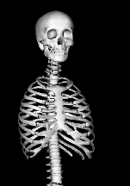
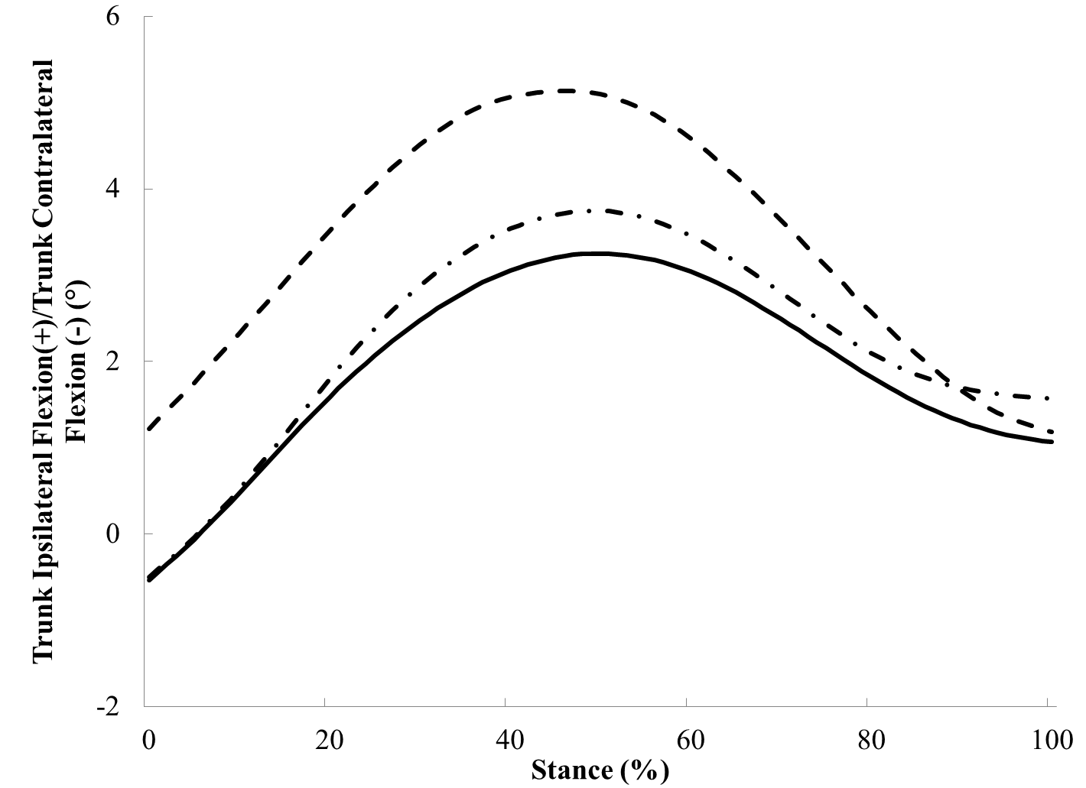
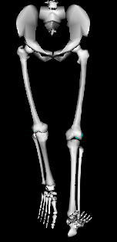
Results: Trunk Ipsilateral Flexion (θ)
$$θ$$
Current ITBS
Previous ITBS
Controls
Foch et al., 2015. Gait Posture;41:706-10.

Slide 12
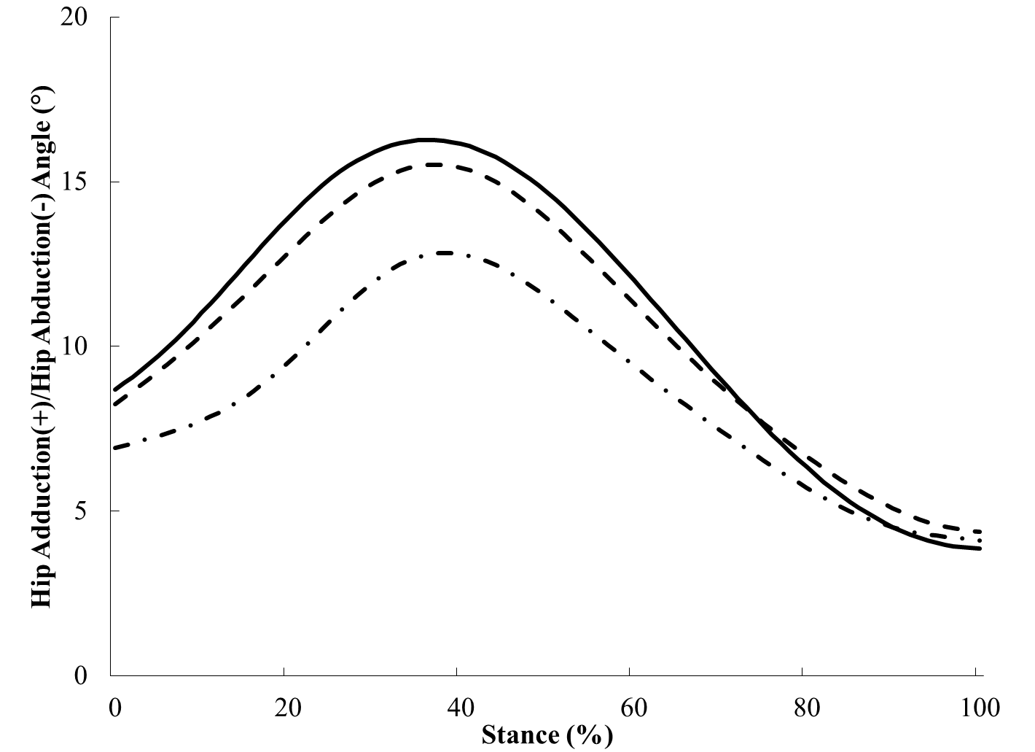
Results: Hip Adduction (θ)
Current ITBS
Previous ITBS
Controls
$$θ$$
Foch et al., 2015. Gait Posture;41:706-10.

Slide 13
Results: Iliotibial Band Flexibility
30
25
20
Iliotibial Band Flexibility (°)
15
10
5
0
Previous ITBS Controls
Current ITBS
Notes:
Looking at the stance phase

Slide 14
Results: Hip Abductor Strength
40
35
30
25
Hip Abductor Strength (%BW*height)
20
15
10
5
0
Current ITBS
Previous ITBS Controls
Notes:
Looking at the stance phase

Slide 15
Interpretation
Greater trunk ipsilateral flexion may be a consequence of ITBS
Lower hip abductor strength may be a residual effect of excessive trunk ipsilateral flexion due to injury
Less hip adduction and running with a more vertical trunk during running may be a compensatory strategy to decrease pain when injured
ITBS interventions should target proper trunk motion, as well as strengthen lower extremity musculature even after ITBS symptoms subside
Notes:
Looking at the stance phase

Slide 16
Dissertation Study 2: Principal Components Analysis (PCA)
PCA captures time-varying movement pattern of waveform
Based on the assumption most data can be described by a few dominant modes of variation
Transforms correlated signals into fewer uncorrelated signals
PCA may provide deeper understanding of injury risk factors
Notes:
Think of sample sport season

Slide 17
Performing a PCA: Normalized Hip Adduction Angle
Compile input data for PCA
Standardize input matrix X (Controls & Pre-ITBS)
20 runners per group
Compute covariance matrix (C) of the standardized matrix X
PCA performed using eigendecompostion of matrix C
End up with three new matrices
Statistically analyzed matrix → PC scores matrix
Each participant’s score on all 101 PCs
Only need ~3 PCs to explain the hip adduction angle
Notes:
Eigenvector matrix (101x101) → 101 PCs contain coefficients that are the loading each variable has on a PC
Eigenvalue matrix (101x1) → indicate relative contribution each PC has on the total variance in the data

Slide 18
Results (Previously): Hip Adduction (θ)
Current ITBS
Previous ITBS
Controls
Foch et al., 2015. Gait Posture;41:706-10.

Slide 19
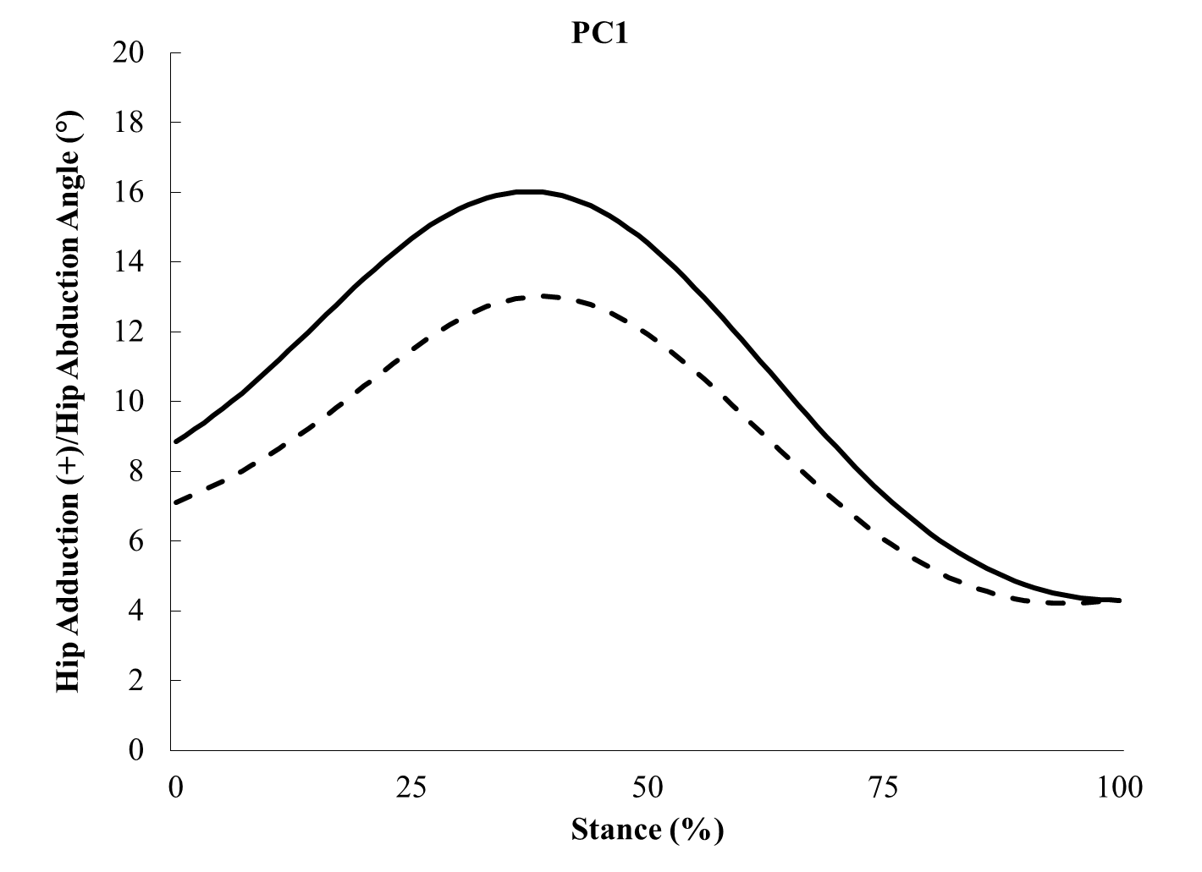
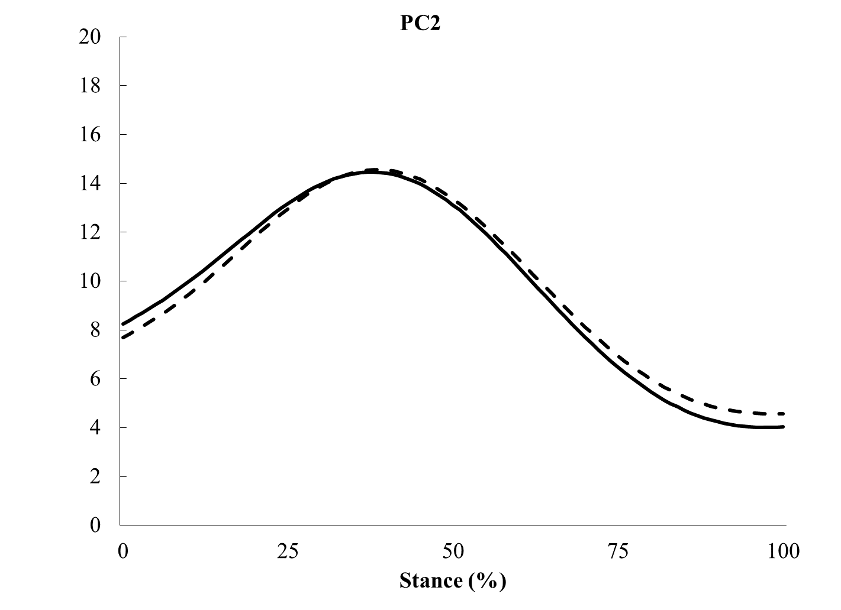
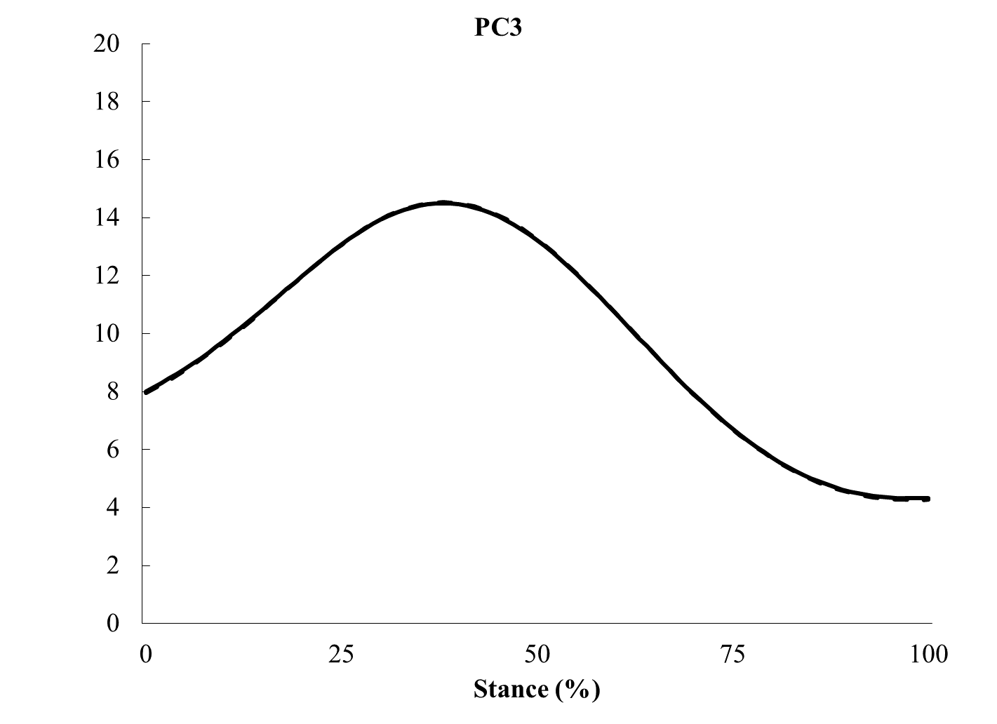
Retained Principal Components 1-3: Hip Adduction
Principal Component 1
Principal Component 2
Principal Component 3
Previous ITBS
Controls
Foch and Milner., 2014. J Biomech;47:81-6.
Notes:
95.6% of the total variance is explained by 3 PCs

Slide 20
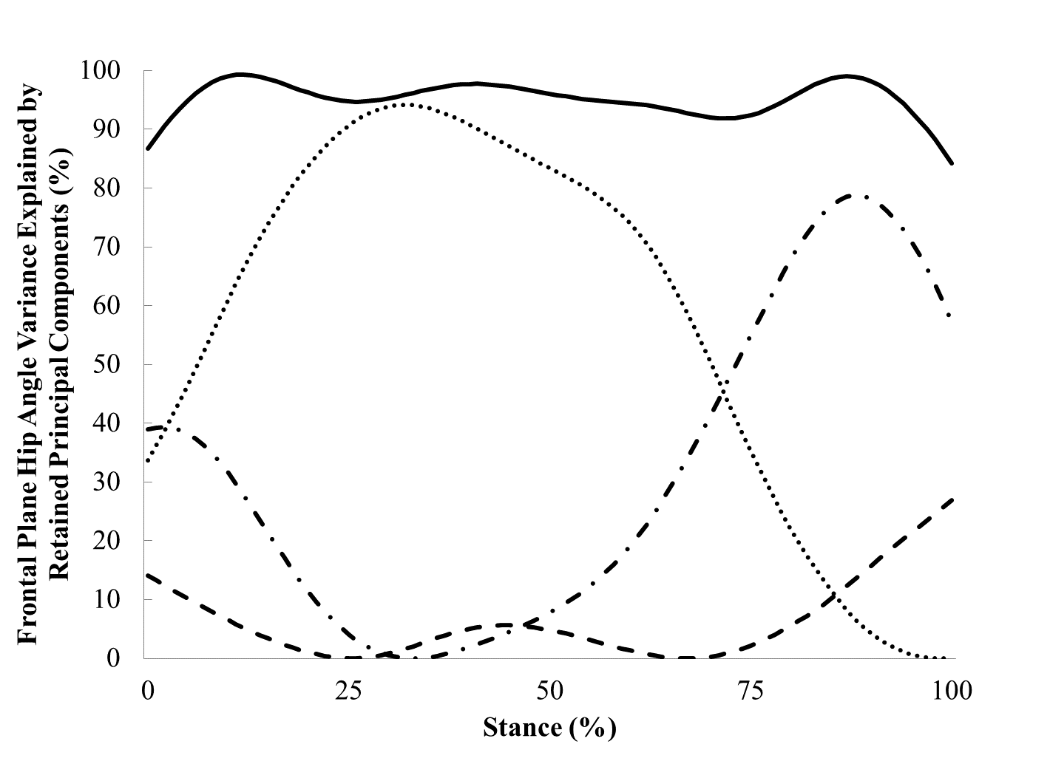
Interpreting The Retained PCs: Normalized Hip Adduction Angle
Fig. Magnitude of hip adduction (PC1) may be attributed to hip abductor musculature acting to restrict motion into adduction
Notes:
PC1 (dot)
PC2 (dash-dot)
PC3 (dash)
Solid is total variance

Slide 21
Hip Neuromechanics In Women With And Without Previous ITBS
Neuromechanics → explain movement patterns via the nervous system and skeletal muscle contraction
From the PCA study: Magnitude of hip adduction (PC1) may be attributed to hip abductor musculature acting to restrict motion into adduction
Purpose: To determine if hip neuromechanics differ during a 30-minute run between women with and without previous ITBS

Slide 22
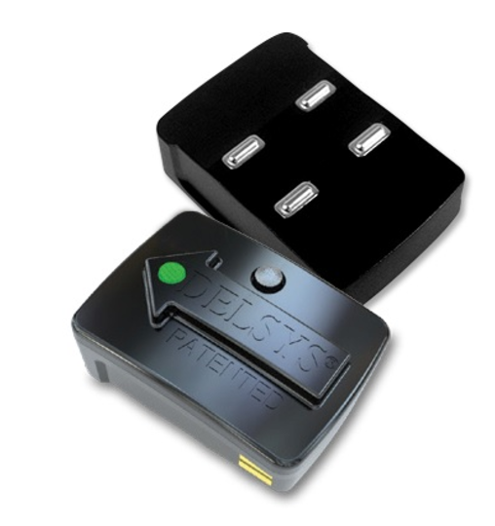
Data Collection
Maximal voluntary isometric contraction (MVIC) hip abductor strength test before and after run
Quiet side-lying trial to establish resting gluteus medius activity
30-minute treadmill run at self-selected speed

Slide 23
Data Collection
MVIC hip abductor strength
Before and after run
During a five second trial at the end of minute 1 and minute 29 of the run
Gluteus medius muscle activity recorded
Lower extremity motion

Slide 24
Gluteus Medius Muscle Activity 150ms Prior to Heel-strike through Toe-off
0.25
Heel-strike
Toe-off
Heel-strike
Toe-off
0.15
Gluteus Medius Muscle Activity
0.05
-0.05
-0.15
0
100
200
300
400
500
Frames (Sampling Frequency 1200 Hz)

Slide 25
Filtered Gluteus Medius Muscle Activity 150ms Prior to Heel-strike through Toe-off
10
-3
14
12
Heel-strike
Toe-off
10
8
Gluteus Medius Muscle Activity
6
4
2
0
-2
0
100
200
300
400
500
Frames (Sampling Frequency 1200 Hz)

Slide 26
Preliminary Results To be Presented at: Northwest Biomechanics Symposium
 | Time | Group |  | ES
 | Min | ITBS (n = 7) | CON (n = 10) | d
Peak hip adduction (°) | 1 29 | 13.8 (2.8) 14.6 (3.5) | 12.5 (2.9) 12.8 (3.5) | 0.43 0.51
Hip adduction excursion (°) | 1 29 | 2.2 (1.9) 3.2 (3.1) | 3.5 (2.6) 4.6 (2.1) | 0.53 0.50
Gluteus medius activity duration (ms) | 1 29 | 107 (26) 113 (49) | 132 (38) 146 (41) | 0.78 0.73
Hip abductor strength (%BW∙h) | 1 29 | 9.5 (3.4) 8.4 (4.2) | 11.1 (4.3) 10.6 (5.1) | 0.42 0.48
Notes:
Do not have enough participants for a mixed-model ANOVA

Slide 27
Preliminary Results Presented at: ACSM Annual Meeting (2017)
 | Time | Group |  | ES
 | Min | ITBS (n = 7) | CON (n = 10) | d
Peak hip adduction (°) | 1 29 | 13.8 (2.8) 14.6 (3.5) | 12.5 (2.9) 12.8 (3.5) | 0.43 0.51
Hip adduction excursion (°) | 1 29 | 2.2 (1.9) 3.2 (3.1) | 3.5 (2.6) 4.6 (2.1) | 0.53 0.50
Pre-heel strike gluteus medius activation (%MVIC) | 1 29 | 81.3 (18.3) 93.1 (33.8) | 70.0 (20.8) 69.1 (18.8) | 0.59 0.92
Weight acceptance gluteus medius activation (%MVIC) | 1 29 | 98.0 (12.6) 97.1 (7.2) | 89.0 (15.2) 90.9 (24.1) | 0.65 0.40

Slide 28
Interpretation (Preliminary)
Female runners with previous ITBS activated gluteus medius for a shorter duration than controls throughout the treadmill run
But, ITBS group activated gluteus medius more to achieve the same hip adduction angle as controls throughout the 30-minute treadmill run
Hip abductor strength was similar between groups and strength did not decrease after the run.

Slide 29
Hip Neuromechanics In Women With And Without Previous ITBS
Still need at least 5-7 women with previously diagnosed and treated ITBS
Study’s inclusion criteria
Currently all female runners must be injury-free for at least 1 month prior to participating
Running at least 6 miles per week
Never had major lower extremity injury, for example, ACL tear
Thank You!

