Slide 1
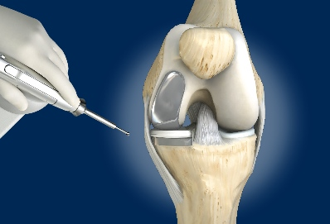
MAKOplasty
Partial Knee Replacement
Bruce Rolfe MD
Eastside Orthopedics
Kirkland
EvergreenHealth

Slide 2
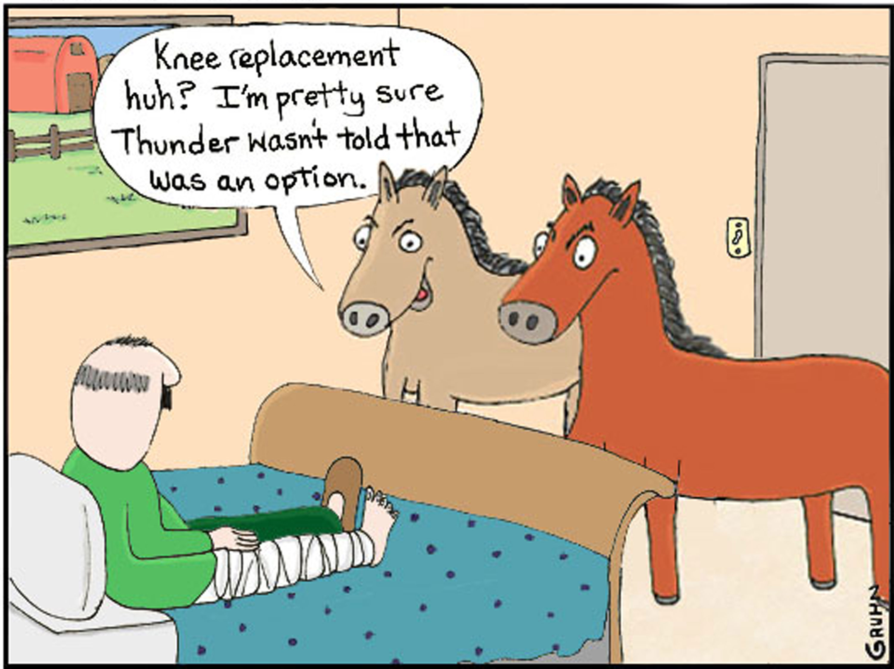
Knee replacement options

Slide 3
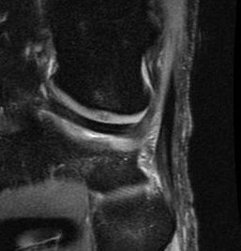
What is the problem?
bone-on-bone

Slide 4
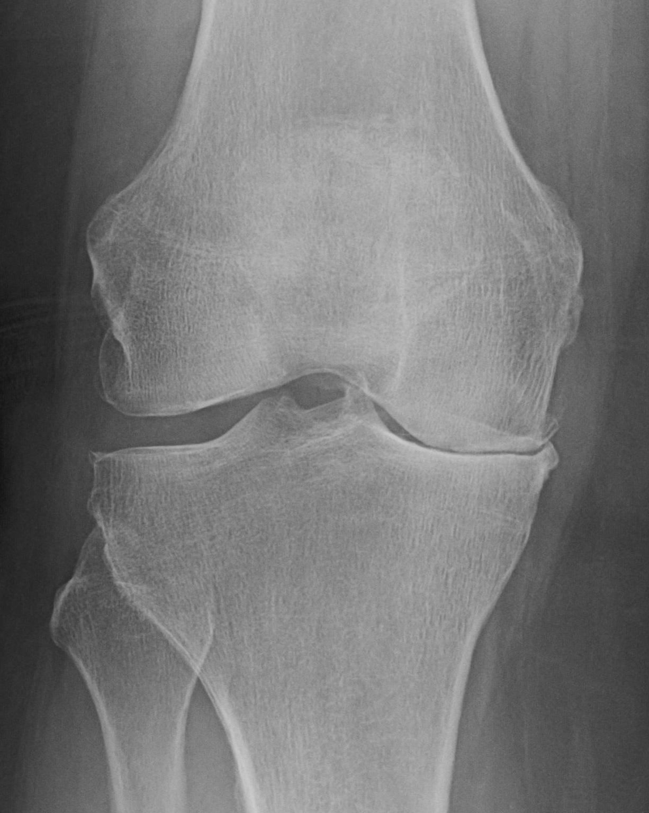
bone–on–bone
Non-surgical Treatment:
Conditioning
Physical Therapy
Oral medication
Topicals
Weight loss
Good shoes
Glucosamine sulfate
Bracing
Injections

Slide 5
bone–on–bone
Surgical goals:
restore joint space
protect the bone

Slide 6
bone–on–bone
Surgery:
Total Knee Replacement
Partial Knee Replacement

Slide 7
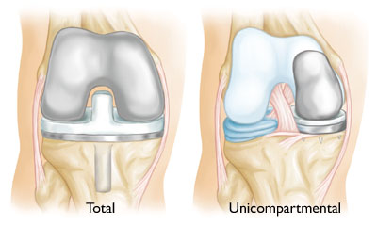
bone–on–bone
Surgery:
Total Knee Replacement
Partial Knee Replacement

Slide 8
Partial verses Total Knee Replacement
Roughly 1 in 3 patients considering total knee replacement would be candidates for partial knee replacement.

Slide 9
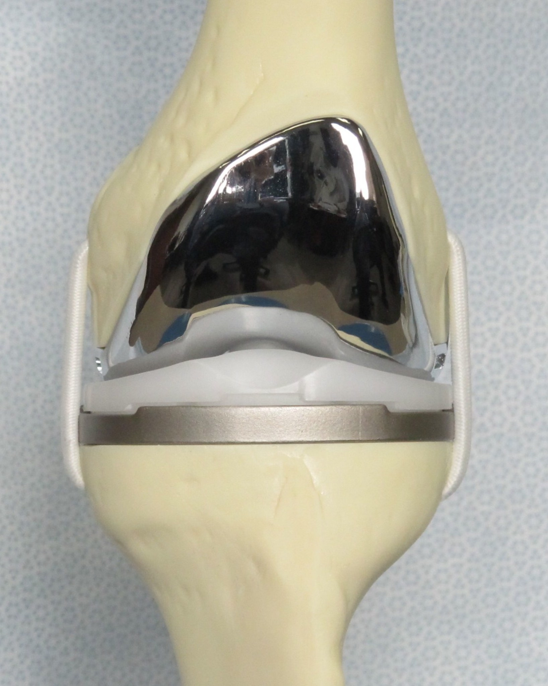
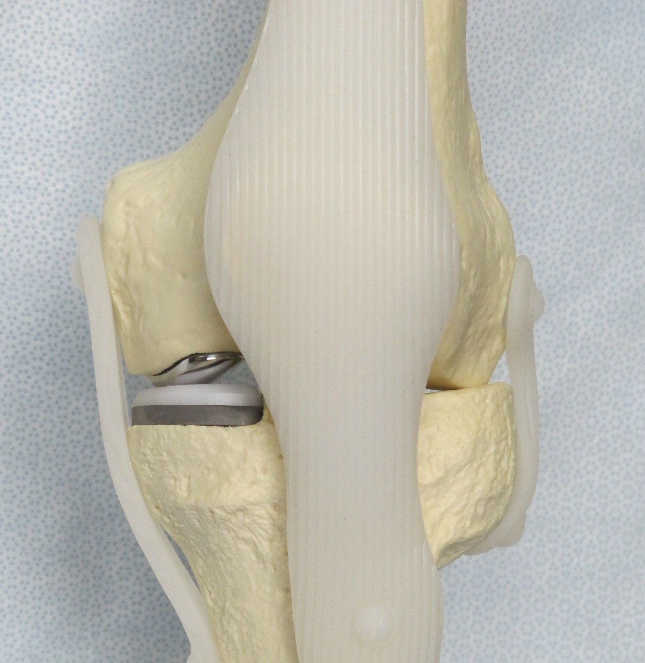
Knee Replacement choices
Total Knee
Much greater control
Adjust in three planes
Rebalance ligaments for straight knee
Much greater correction
Partial Knee
Works within the existing ligament and bone structure
Much easier to rehab
“Feels normal”

Slide 10
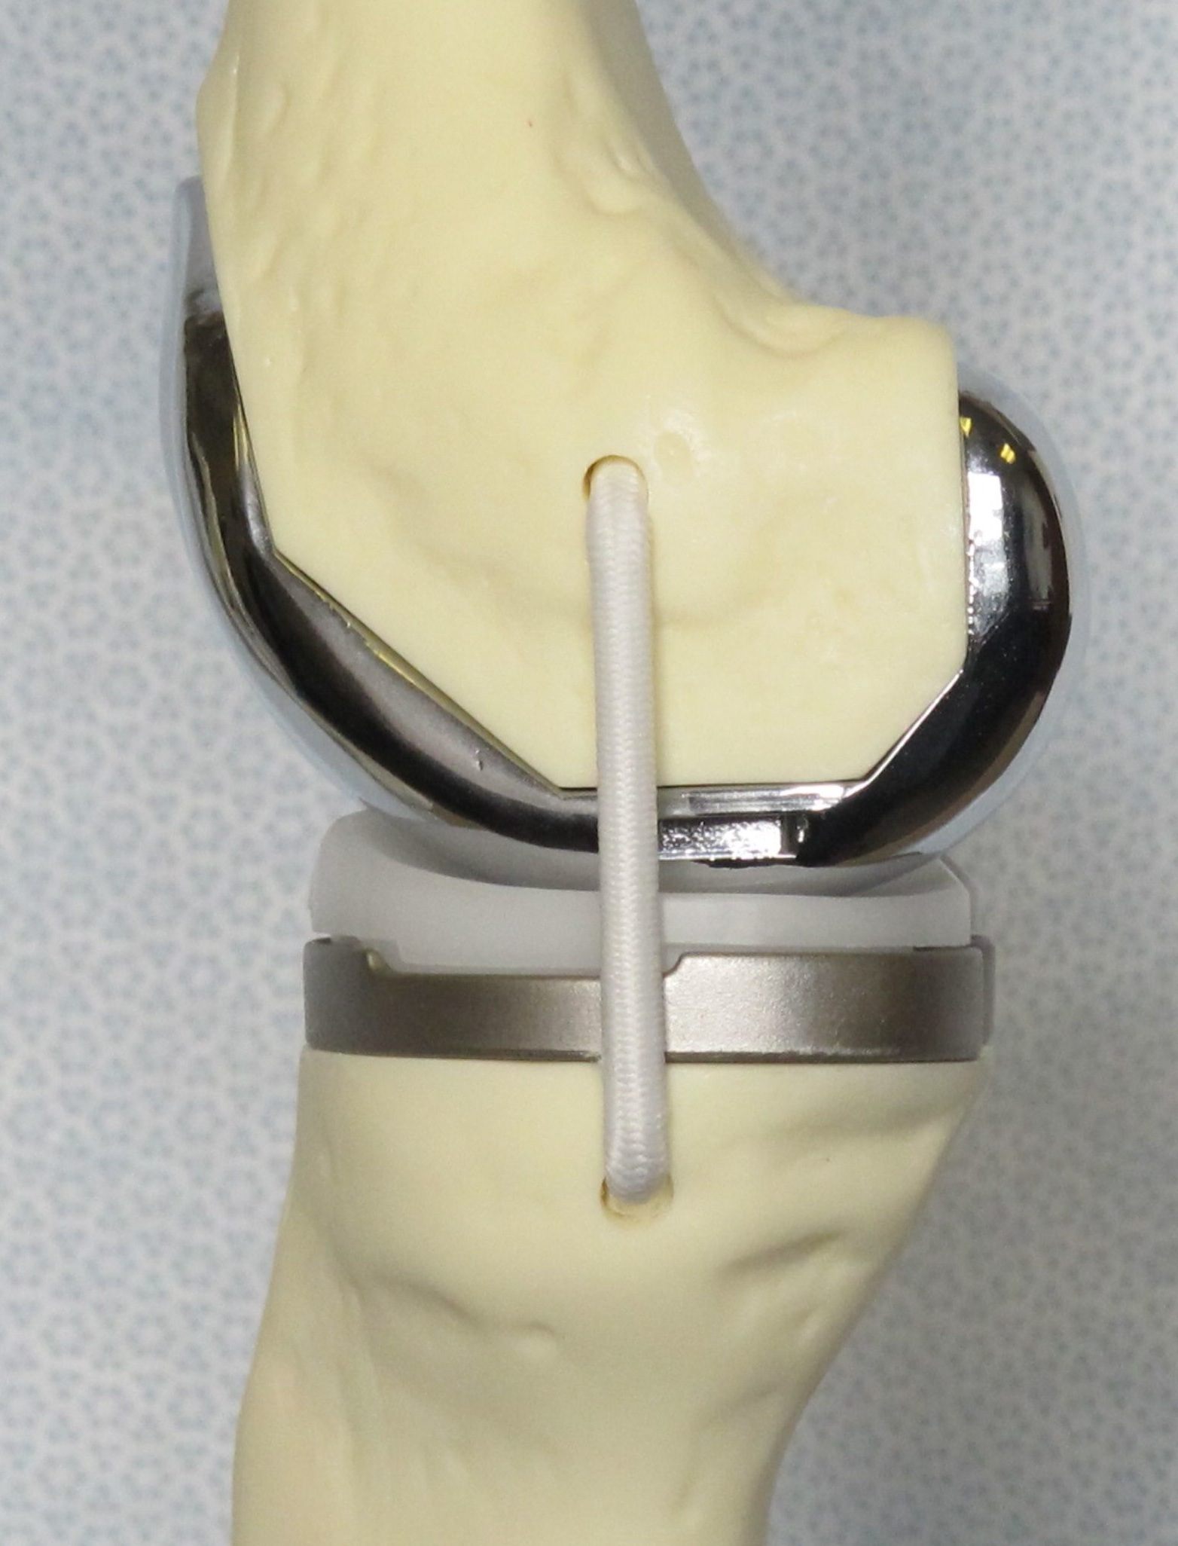
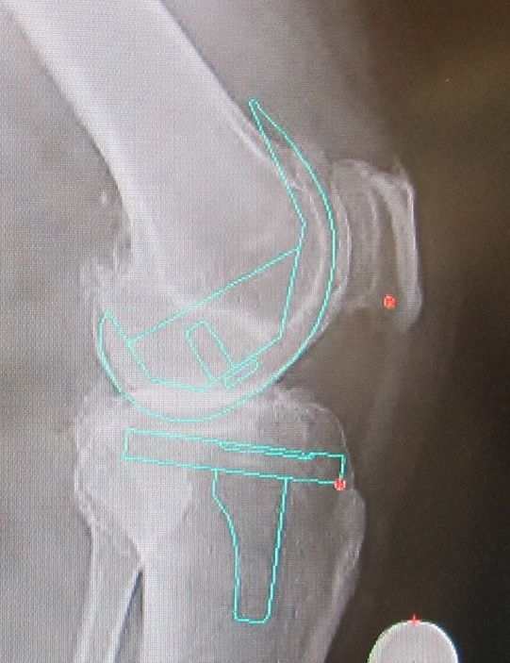
Knee problems requiring total replacement
Tri- compartmental involvement
Axis problems
Contractures
Inflammatory arthritis

Slide 11
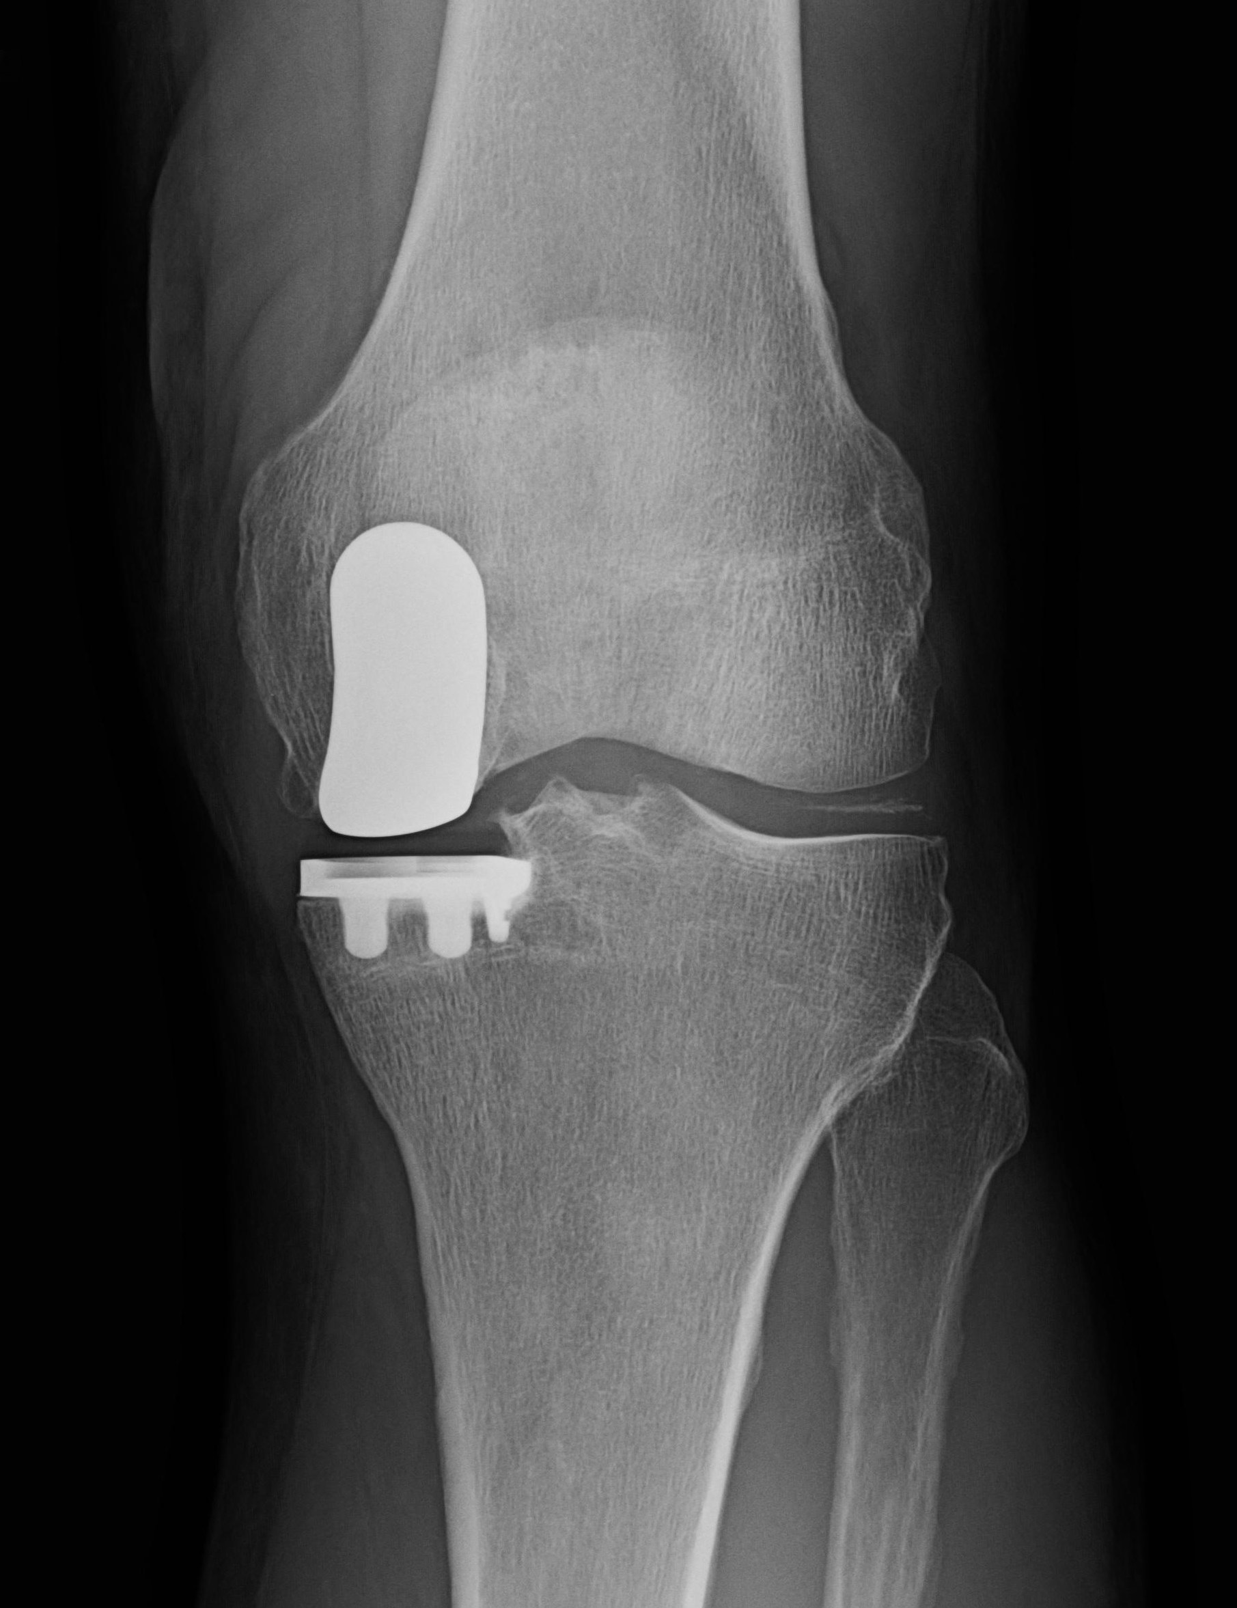
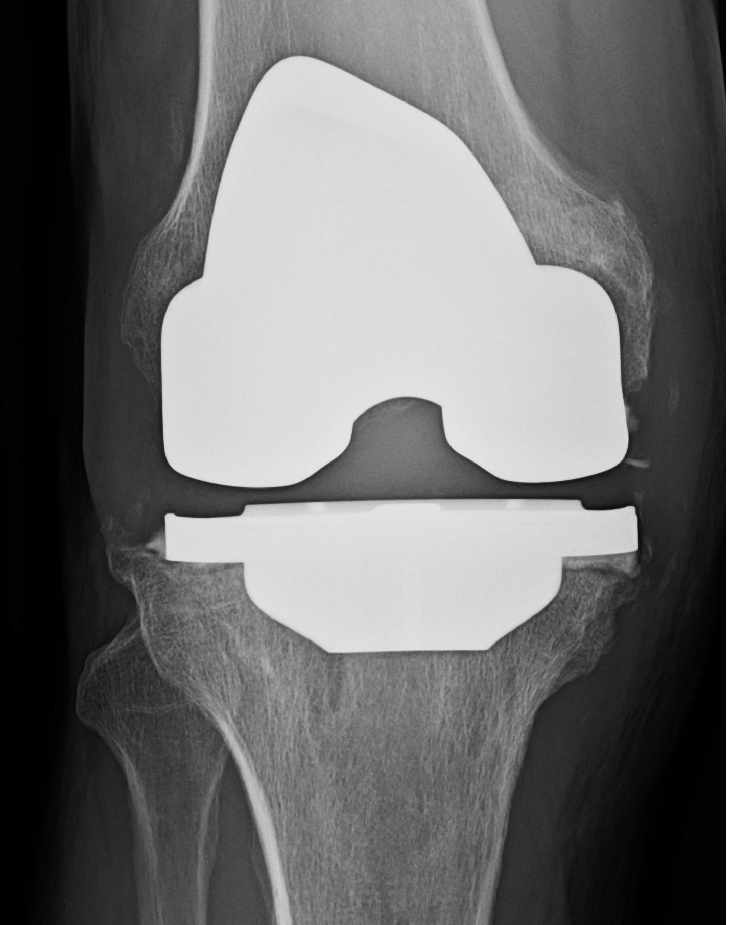
Arthritis of the Knee Surgical Choices

Slide 12
Partial Knee Replacement
30+ years
Large exposure
Hand carpentry
Burr methods
Jig methods
MAKO

Slide 13
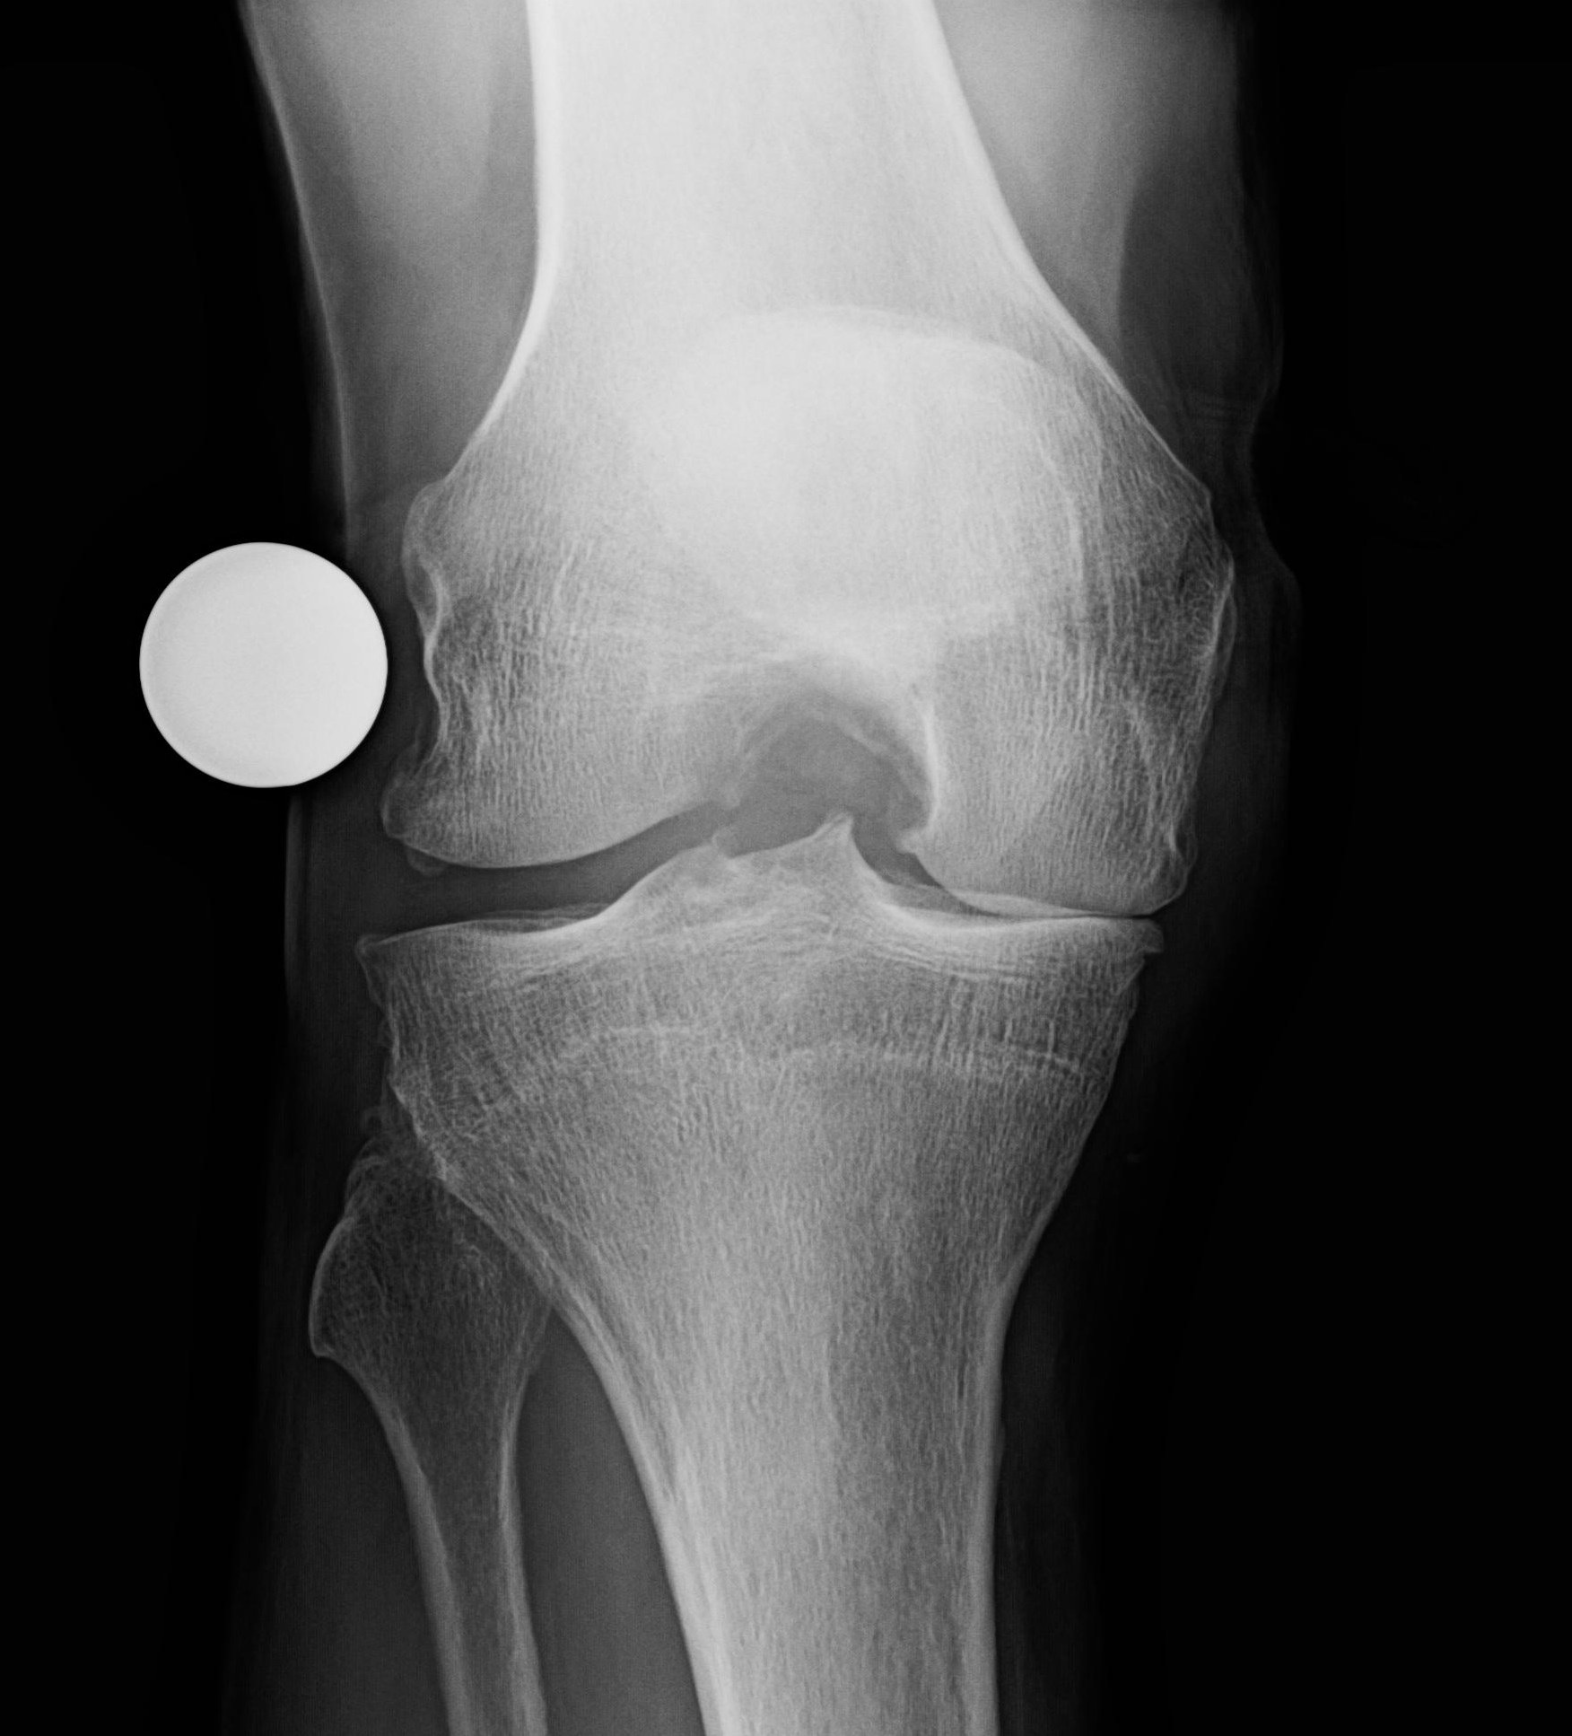
Partial Knee Replacement
H.R. 71 year old rancher from Ellensberg

Slide 14
Partial Knee Replacement
“Knee is fabulous!!! No pain, no Swelling, no limp, no pills walk straight. Thanks for a good job!!!! Just sorry I did not do it 4 years ago”
Harland 3/5/2014

Slide 15
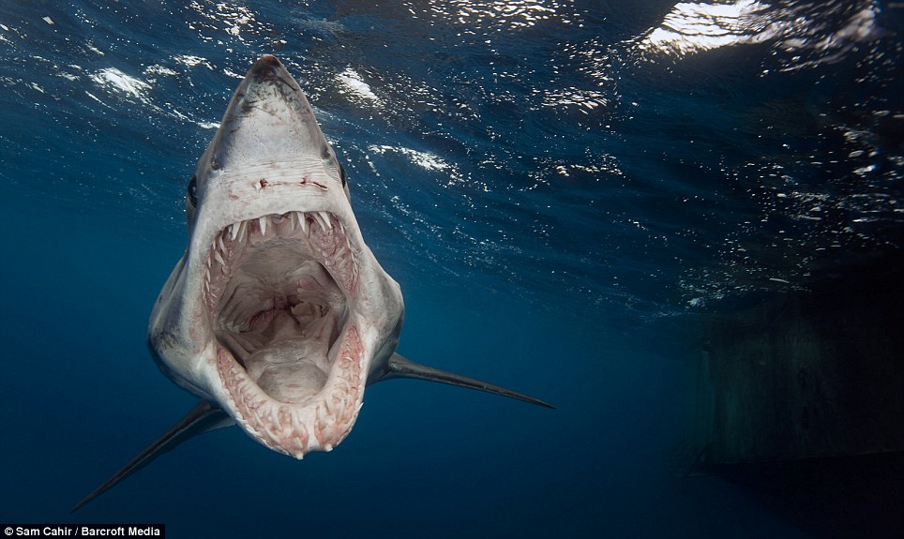
What is a MAKO?

Slide 16
What is MAKOplasty?
MAKOplasty is a robotically assisted partial knee replacement.

Slide 17
What is MAKOplasty?
The robot allows a smaller dissection and is MUCH more precise than freehand or jig methods.

Slide 18
What is MAKOplasty?
Result:
Less pain
Easier rehab
Predictable results

Slide 19
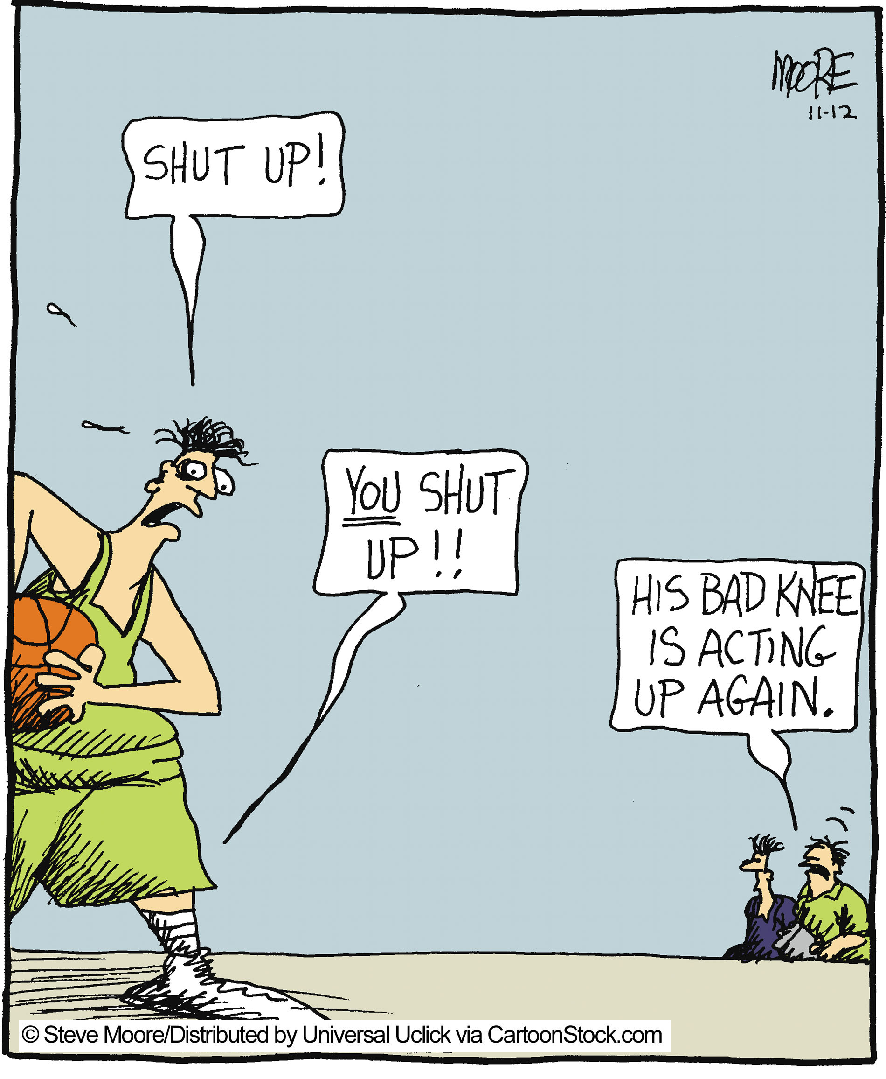
the secret
I didn’t believe it.

Slide 20
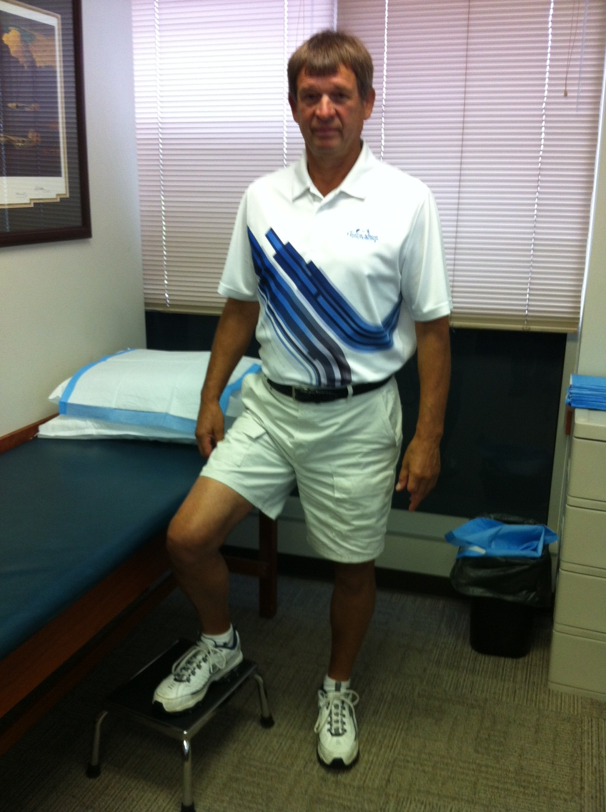
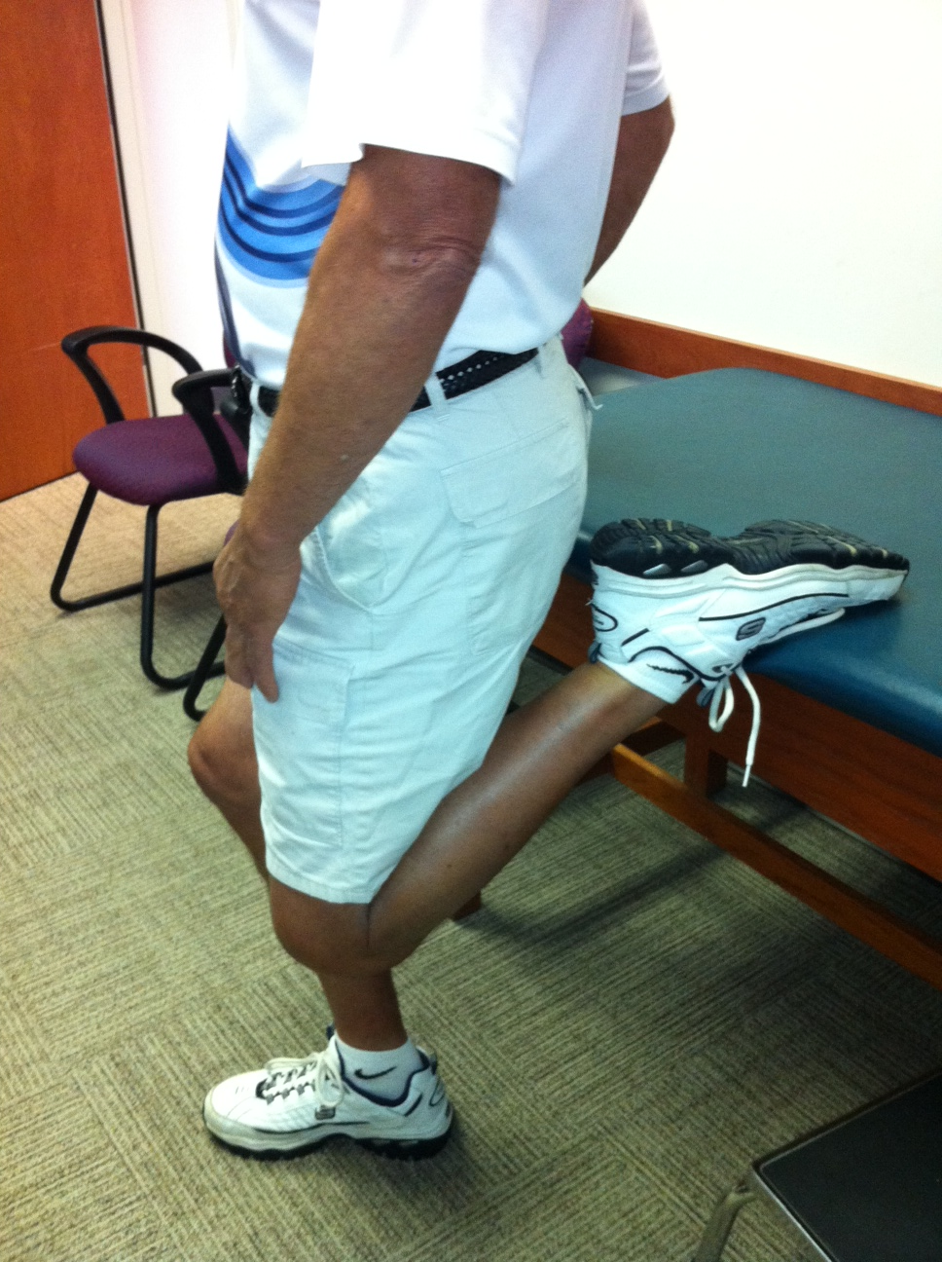
believe it
J.S. 71 yrs old
MAKOplasty 7/2013
Golfing
No pain

Slide 21
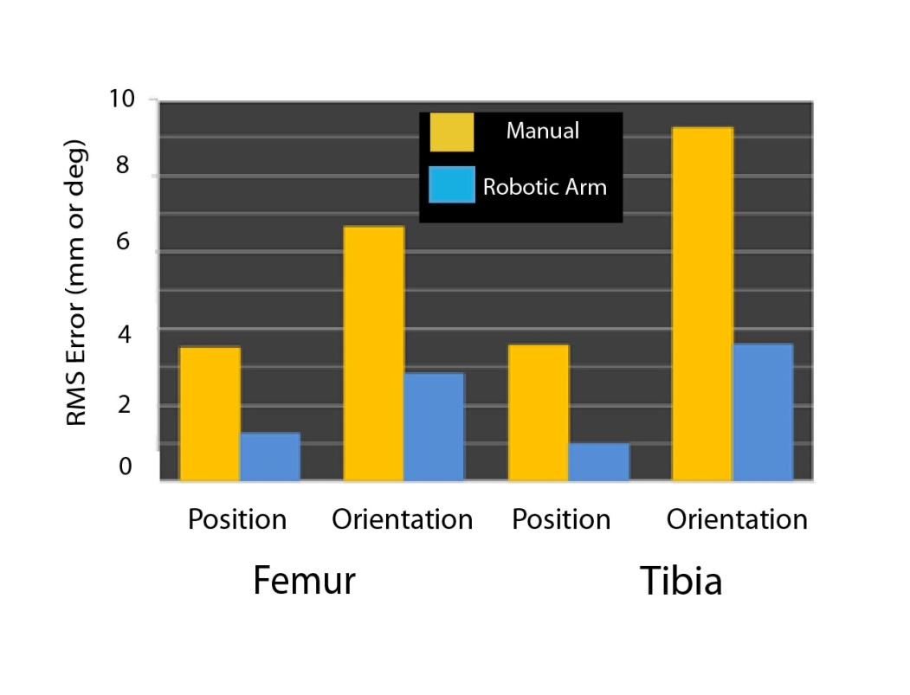
MAKOplasty
Robotic arm assisted UKA leads to component placement that is:
2 to 3 times more accurate
at least 3 times more reproducible
with fewer outliers
Lonner JH, John TK and Conditt MA. Robotic Arm Assisted UKA Improves Tibial Component Alignment. Clin Orthop Relat Res, 2009.
Coon T, Driscoll MD, Horowitz S, Conditt M. Robotically Assisted UKA is More Accurate than Manually Instrumented UKA. Presented at American Academy of Orthopedic Surgeons. New Orleans, LA. 2010
Pearle AD, O’Loughlin PF, and Kendoff DO: Robot Assisted Unicompartmental Knee Arthroplasty. J Arthroplasty, 2008.
Argenson J-NA, Parratte S, Bertani A, Aubaniac J-M, Lombardi AV, Berend KR, Adams JB, Lonner JH, Mahoney OM, Kinsey TL, John TK and Conditt MA: The New Arthritic Patient and Arthroplasty Treatment Options. J Bone Joint Surg Am, 91-A: 43-48 2009.
Dunbar NJ, Pearle AD, Kenoff D, Conditt M, Banks S. Is UKA More Accurate with Robotic Assistance? Presented at the Orthopedic Research Society. New Orleans, LA 2010.
Sinha, R.K.: Outcomes of Robotically Assisted Unicompartmental Arthroplasty. American Journal of Orthopedics, XXXVIII(2S): 20-22, 2009.

Slide 22
MAKOplasty workflow
Pre Op
Intra Op preparation
Intra Op bone work
CT scan
3D Image
Trackers attached to Femur & Tibia
3D image is registered with patient
Ligament compliance is measured
Virtual components are placed and tested
Fit and balance are confirmed
Bone resected
Implants are placed

Slide 23
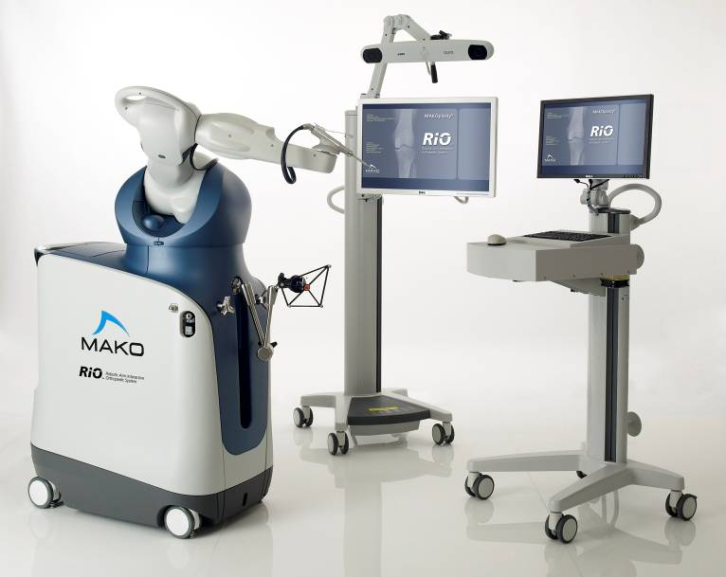
Why is MAKO cool?
Types of robotic surgery:
Autonomous
Remote – da Vinci
Shared control - MAKO

Slide 24
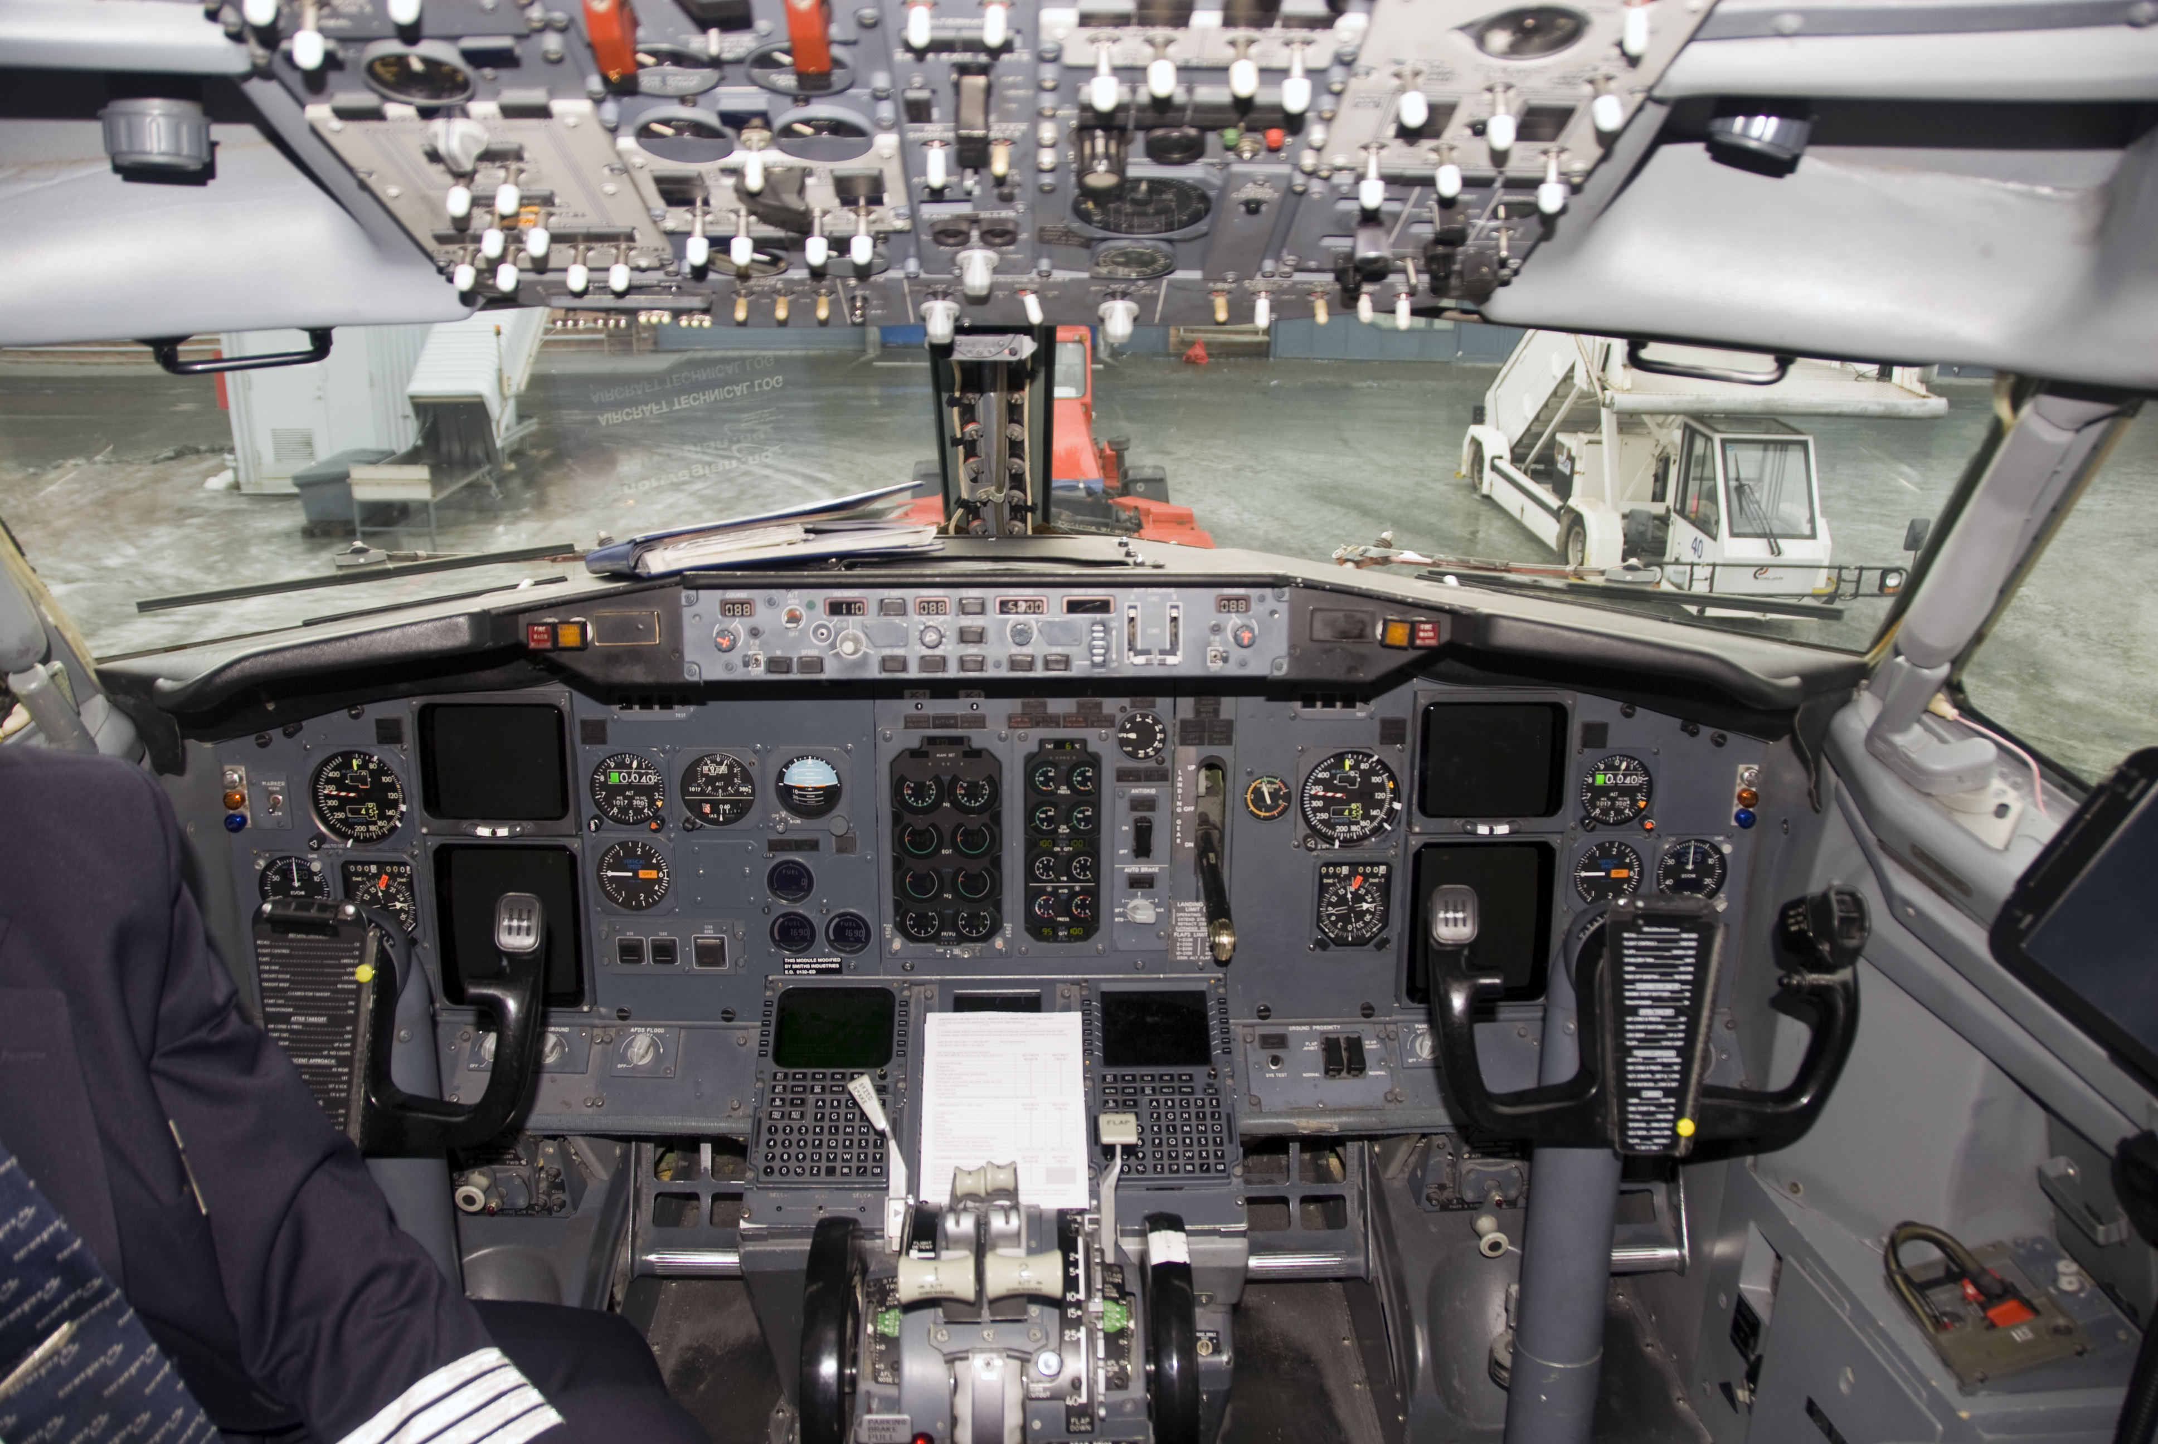
Why is MAKO cool?
Cockpit analogy

Slide 25
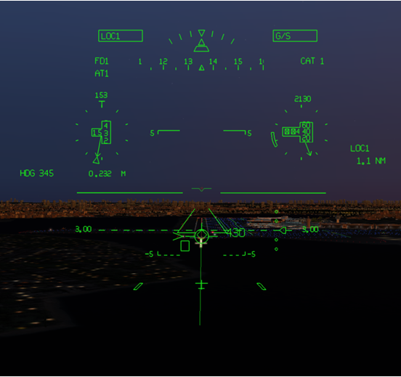
Why is MAKO cool?
HUD analogy – shared control

Slide 26
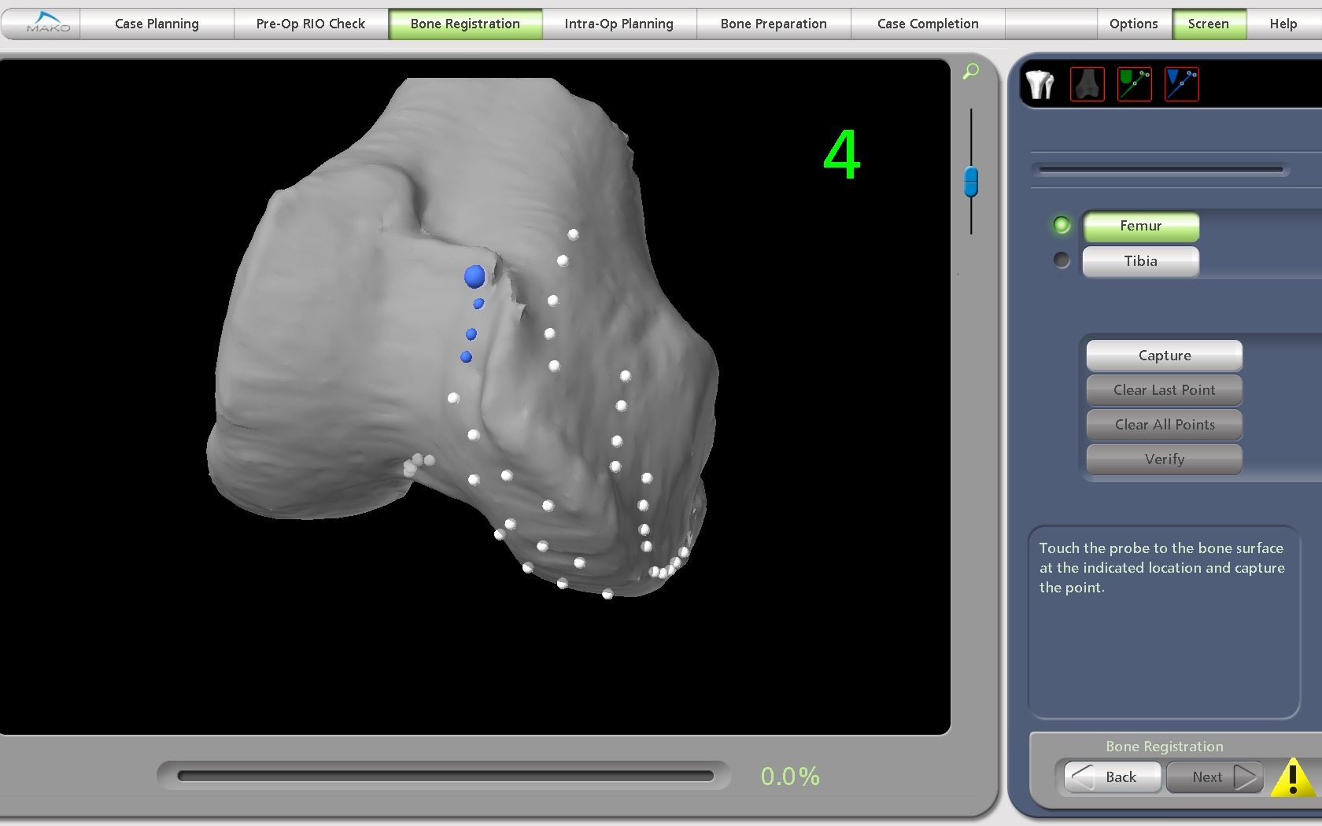
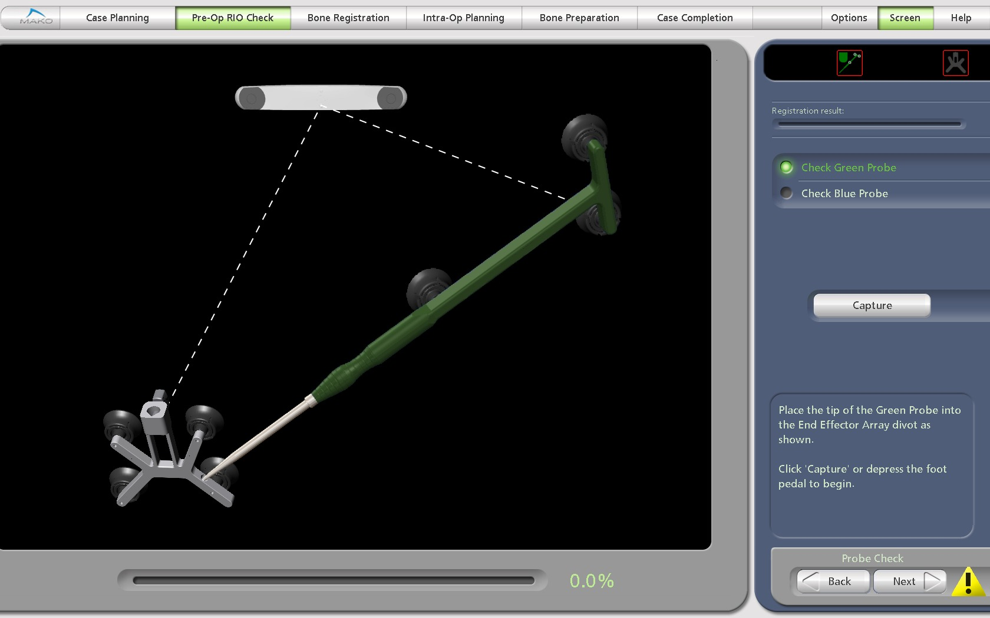
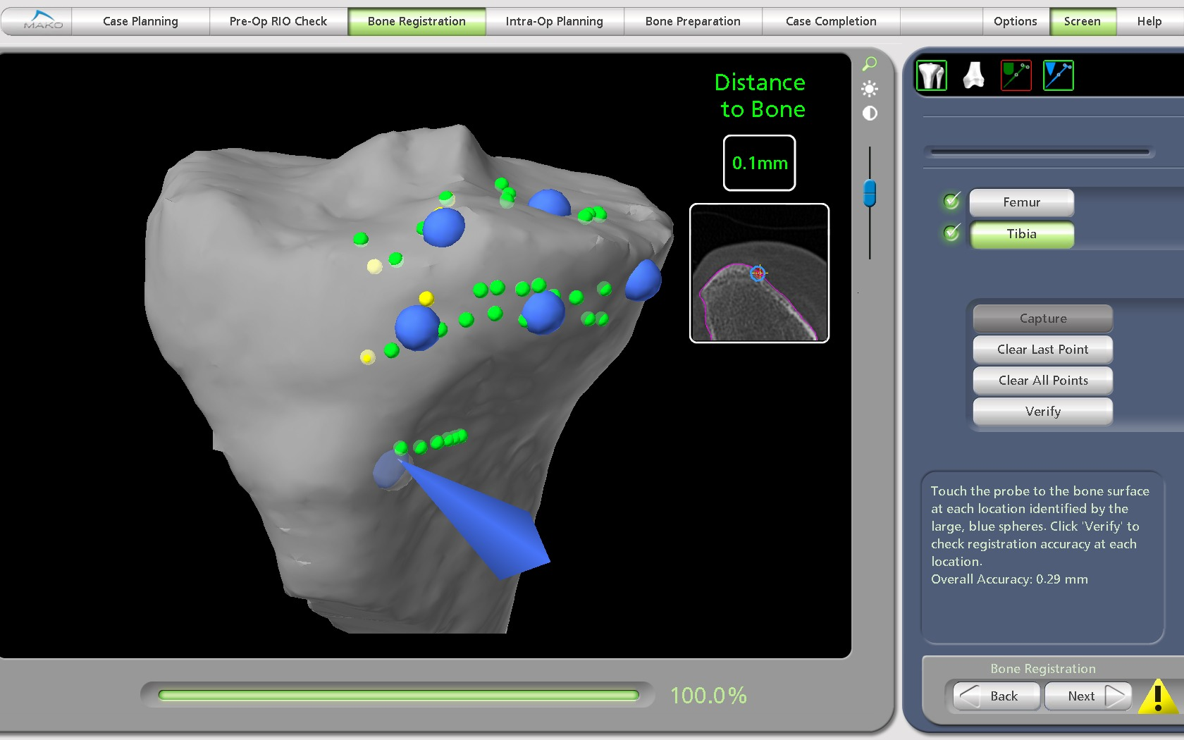
What is MAKO robotic surgery?
Computer navigation
Imaging with CT scan
Registration
Modeling
Planning

Slide 27
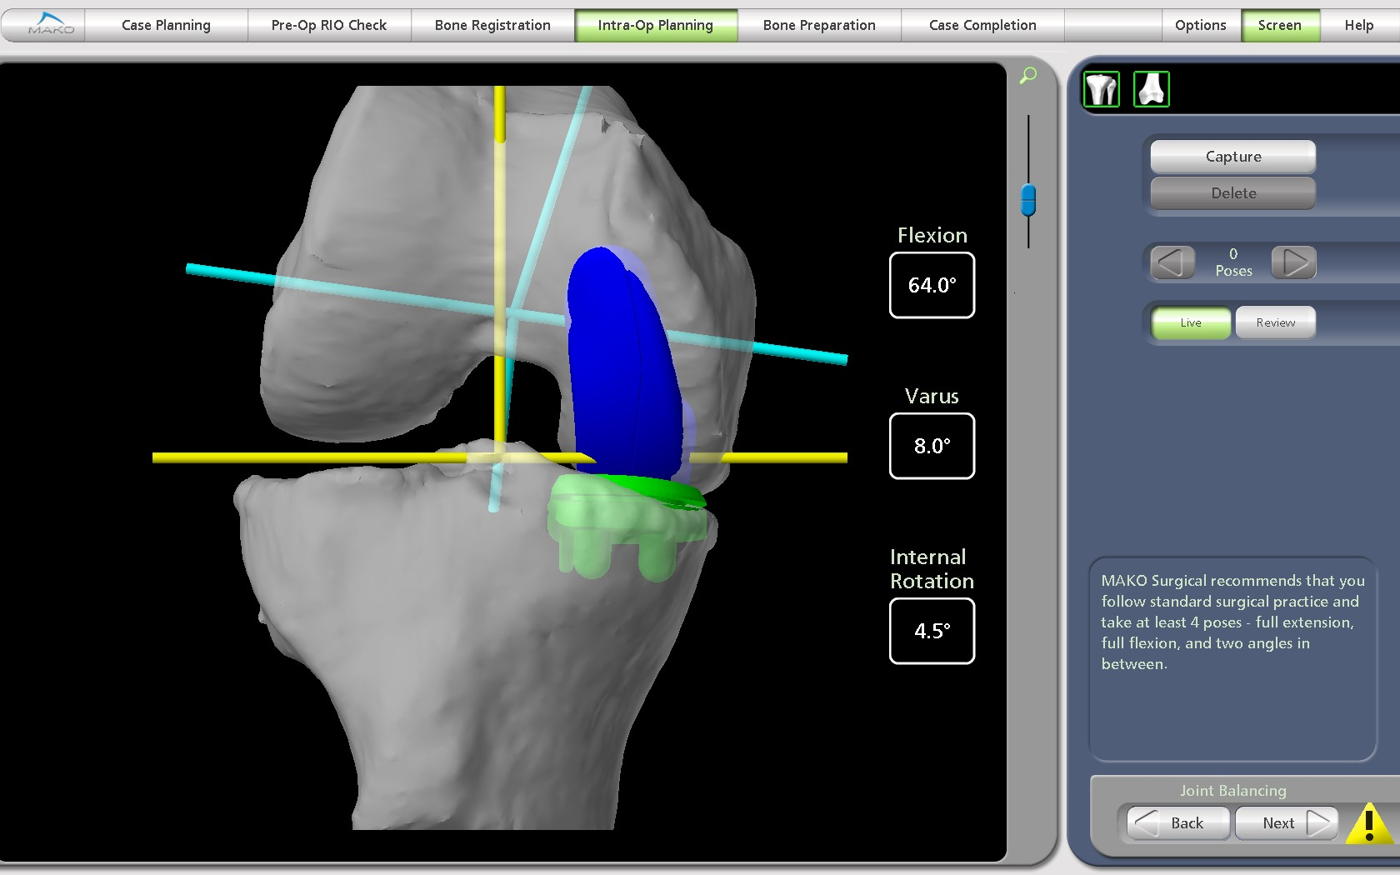
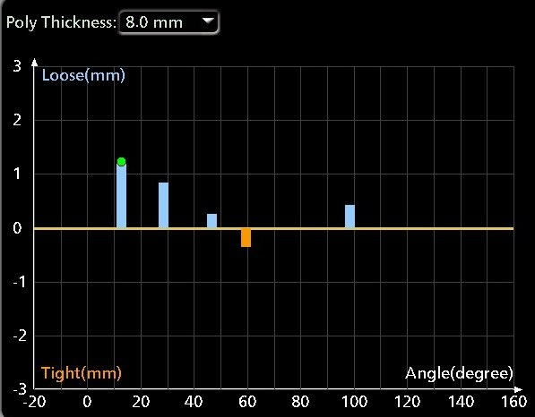
MAKO planning and balancing
All the fit, all the balancing is done before the first bone cut.

Slide 28
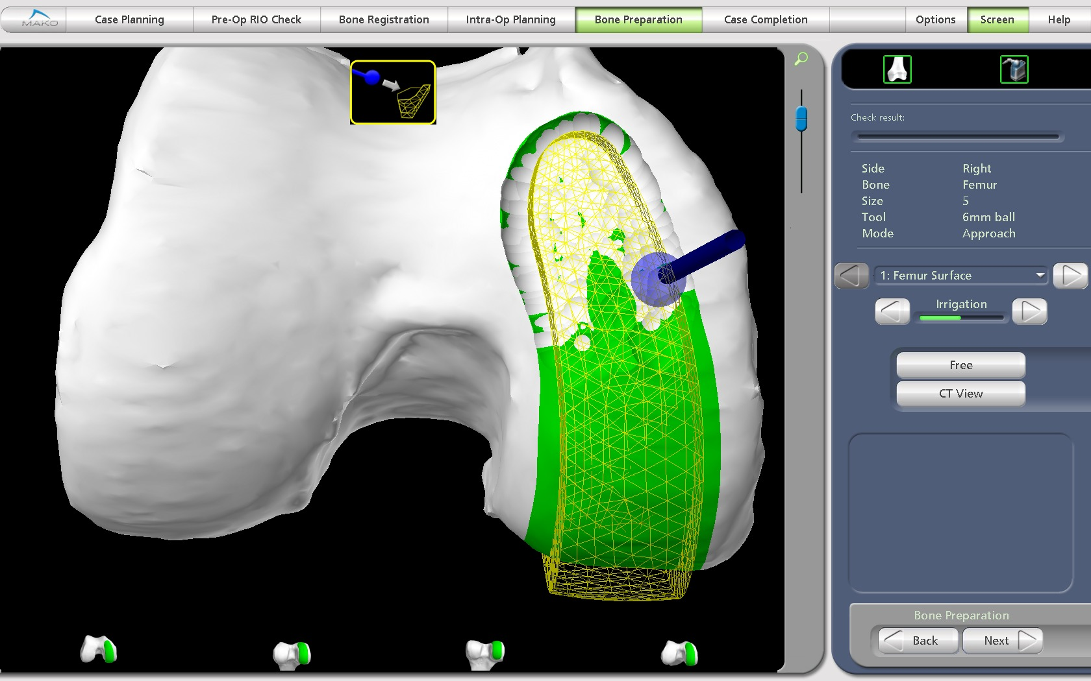
What is MAKOplasty robotic surgery?
Robotic
Surgeon works within “haptics”
Shared control

Slide 29
Why is MAKO cool?

Slide 30
Who gets a MAKOplasty?
One compartment involved (?Two)
Alignment and extension within 10 degrees of neutral
Stable
Reasonable body weight

Slide 31
Why is MAKOplasty cool?
Outpatient surgery
Retain the cruciates.
“The knee feels normal”

Slide 32
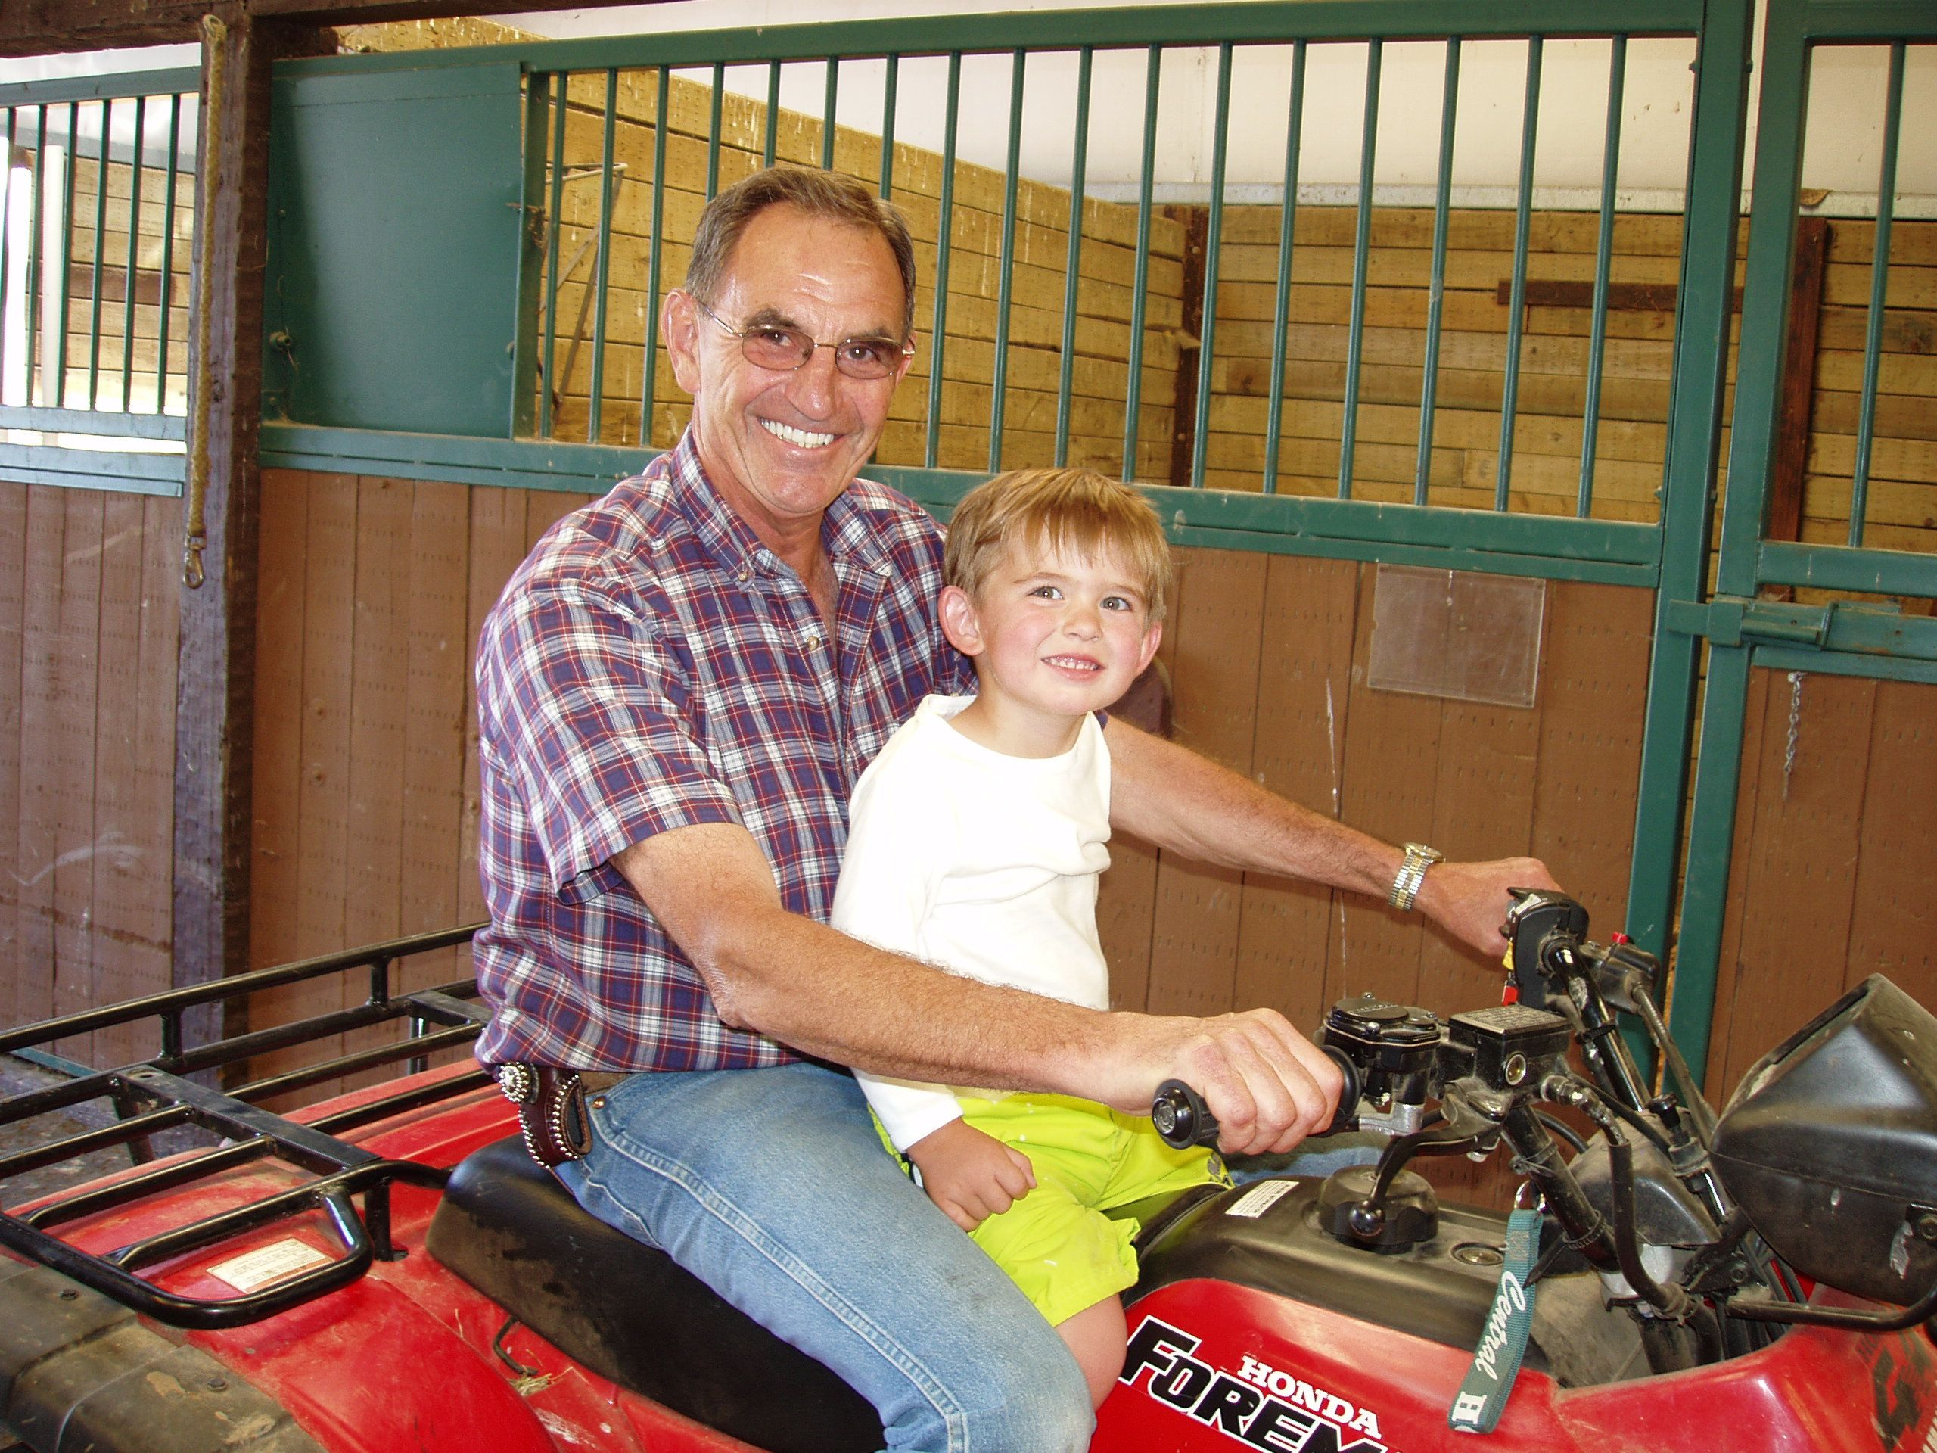
Why is MAKOplasty cool?
Outpatient surgery
Retain the cruciates.
“The knee feels normal”

Slide 33
Why is MAKOplasty cool?
Video post op patient
Bruce Rolfe MD
Eastside Orthopedics
Kirkland
May 14, 2014 POD #1

