Slide 1
Caring for Your Back: Surgical and Non-Surgical Options
Addison Stone, M.D.
Board Certified Spine Surgeon
Specializing in Minimally Invasive Spine Surgery
April 20, 2017

Slide 2
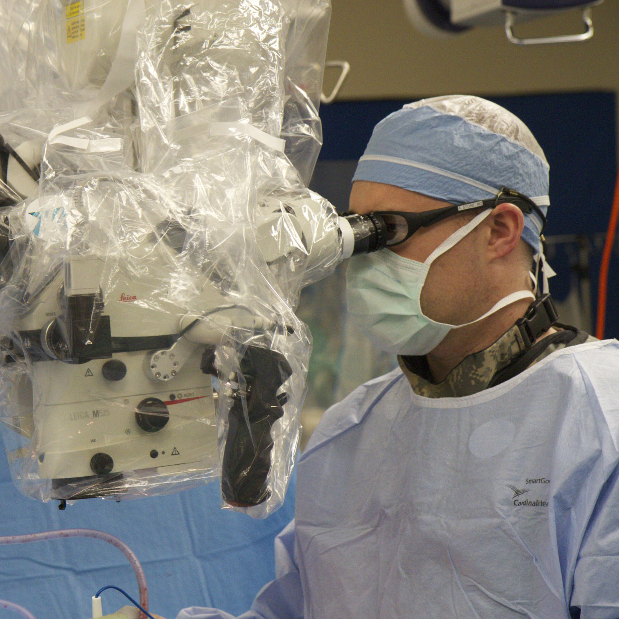
My Practice
Board certified: American Board of Orthopaedic Surgeons (ABOS)
100% spine
Minimally invasive spine surgery
Notes:
I am a board certified orthopaedic surgeon
100% of elective practice is spine

Slide 3
My Practice
Adult & pediatric
Scoliosis and degenerative spine conditions
Disc replacement
Computerized spine navigation
Notes:
I am a board certified orthopaedic surgeon
100% of elective practice is spine

Slide 4
Objectives
Degenerative conditions affecting the spine
Anatomy of the spine
Surgical & nonsurgical treatment options

Slide 5
Spinal Conditions
Other
3%
(i.e., trauma, tumors, infections)
Degenerative Conditions
27%
(“Aging”)
Idiopathic
70%
Notes:
- To understand causes of back pain and other spine problems, it is imperative to understand conditions of the spine that cause these symptoms.
This slide is of patients presenting to clinicians.
Since degenerative conditions are the main cause of spine problems, that will be the focus of my talk.

Slide 6
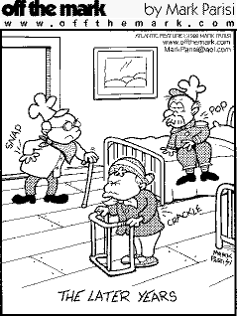
What are Degenerative Conditions?
Natural Aging- “Wear and Tear”
The Snap, Crackle, and Pop Years

Slide 7
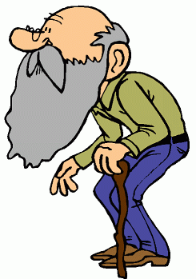
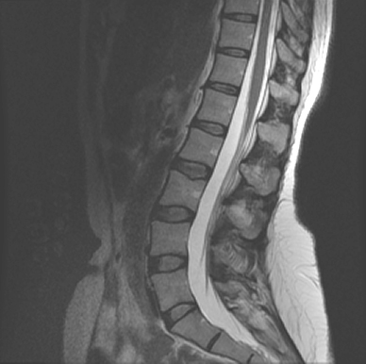
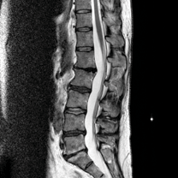
What Happens with Age?
Notes:
Use CT myelogram if a MRI is contraindicated (i.e., pacemaker)

Slide 8
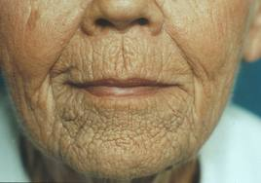
Degenerative Conditions
Degenerative conditions of the spine
Wrinkles
Notes:
If you live long enough you will get them.

Slide 9
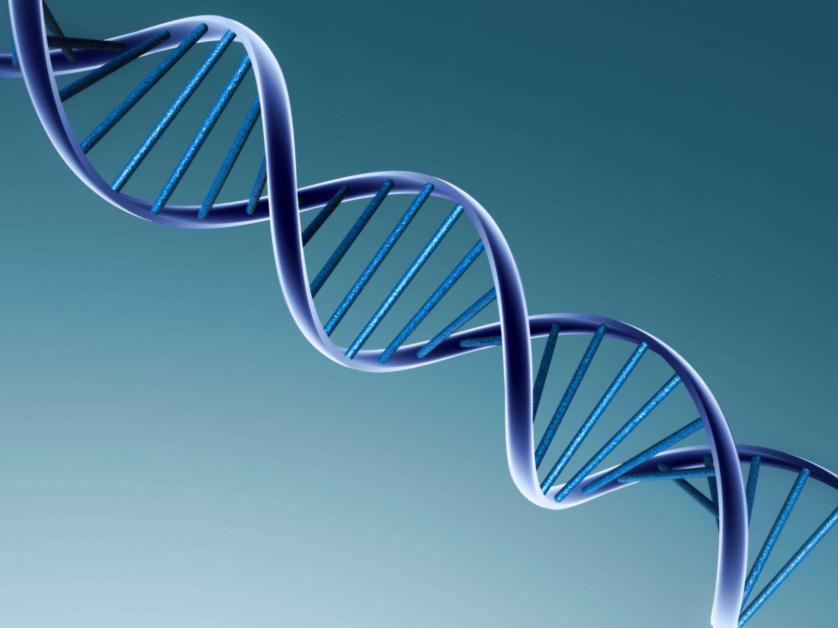
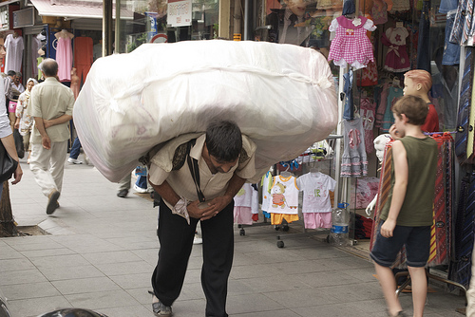
Causes of Degenerative Conditions
Genetics
Environmental Factors

Slide 10
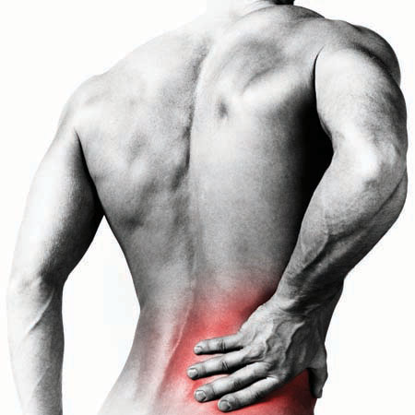
Degenerative Conditions
Degenerative Discs/ Facet Arthritis
Disc Herniations
Spinal Stenosis
Spondylolisthesis
Notes:
Will review the cause of these conditions as well as treatment options.

Slide 11
#1 Degenerative Discs & Facet Arthritis

Slide 12
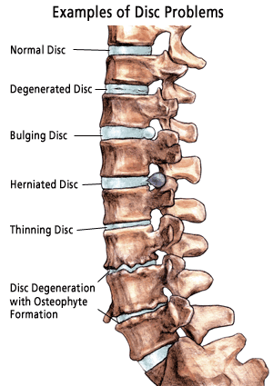
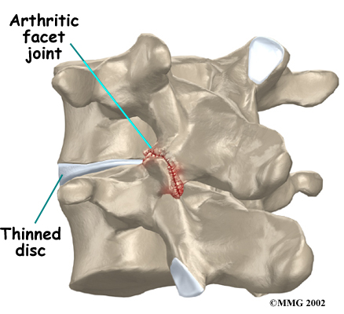
Degenerative Discs & Facet Arthritis

Slide 13
Degenerative Discs & Facet Arthritis
Symptoms
Localized pain
Neck/ shoulder pain
Back/ buttock pain

Slide 14
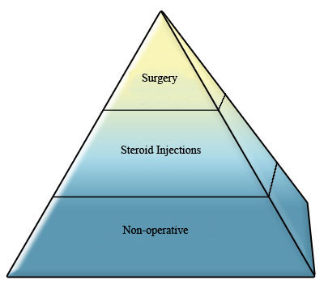
Three Tiers of Treatment

Slide 15
Tier #1 Non-operative Treatment
Rest/activity modification
Ice/heat
NSAID’s (limit narcotics)
Muscle relaxants
Short course of oral steroids
Weight loss
Physical therapy
Posture/ergonomics
Massage
Acupuncture
Chiropractic
Tincture of time
Notes:
Core strengthening, stretching, and a general aerobic exercise program

Slide 16
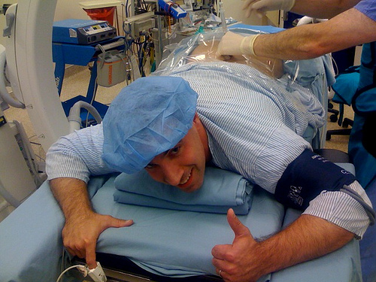
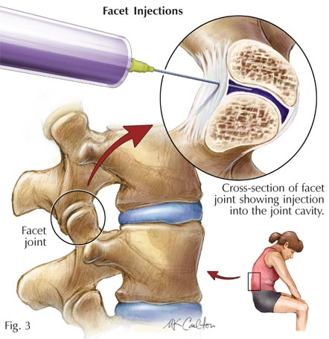
Tier #2 Injections
Facet injections
Medial branch blocks
Neurotomies

Slide 17
Treatment Degenerative Discs & Facet Arthritis
Notes:
Non-op without:
Nerve compression
Hyper-mobility
Unbalanced curves

Slide 18
#2 Disc Herniations

Slide 19
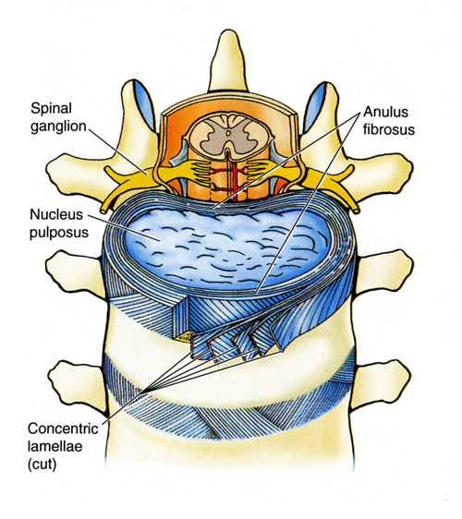
Basic Anatomy Discs- A Jelly Filled Doughnut
Nerve
Compression
Dough: Annulus fibrosis
Jelly: Nucleus pulposus
80% water
25% of spinal column length
Tires
Notes:
Disks are located between the vertebral endplates covered by hyaline cartilage and supported by subchondral bone
Receive nutrients by diffusion from peripheral vascularization
Nucleus Pulposus: Type II collagen in a mucoid material, acts as a shock absorber
Anulus Fibrosis: Type I collagen in layers running in opposite directions, resists rotation, thickess anteriorly and thinnest posterolaterally
People lose height with aging due to loss of disk height

Slide 20
Basic Anatomy Discs- A Jelly Filled Doughnut
Nerve
Compression
Dough: Annulus fibrosis
Jelly: Nucleus pulposus
80% water
25% of spinal column length
Tires
Notes:
Disks are located between the vertebral endplates covered by hyaline cartilage and supported by subchondral bone
Receive nutrients by diffusion from peripheral vascularization
Nucleus Pulposus: Type II collagen in a mucoid material, acts as a shock absorber
Anulus Fibrosis: Type I collagen in layers running in opposite directions, resists rotation, thickess anteriorly and thinnest posterolaterally
People lose height with aging due to loss of disk height

Slide 21
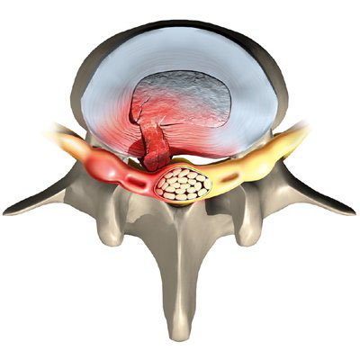
Disc Herniations
Nerve
Compression
Symptoms
Shoulder/ arm pain
Buttock/ leg pain (i.e., sciatica)
Numbness
Loss of a reflex
Muscle weakness
Notes:
Disks are located between the vertebral endplates covered by hyaline cartilage and supported by subchondral bone
Receive nutrients by diffusion from peripheral vascularization
Nucleus Pulposus: Type II collagen in a mucoid material, acts as a shock absorber
Anulus Fibrosis: Type I collagen in layers running in opposite directions, resists rotation, thickess anteriorly and thinnest posterolaterally
People lose height with aging due to loss of disk height

Slide 22
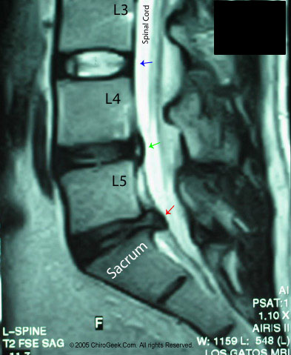
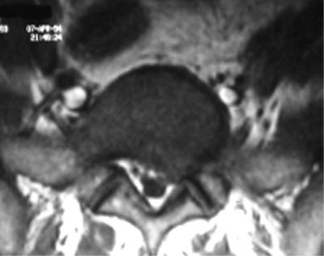
Disc Herniations
Nerve
Compression
Notes:
Disks are located between the vertebral endplates covered by hyaline cartilage and supported by subchondral bone
Receive nutrients by diffusion from peripheral vascularization
Nucleus Pulposus: Type II collagen in a mucoid material, acts as a shock absorber
Anulus Fibrosis: Type I collagen in layers running in opposite directions, resists rotation, thickess anteriorly and thinnest posterolaterally
People lose height with aging due to loss of disk height

Slide 23
Three Tiers of Treatment

Slide 24
Tier #1 Non-operative Treatment
Rest/activity modification
Ice/heat
NSAID’s (limit narcotics)
Muscle relaxants
Short course of oral steroids
Gabapentin
Physical therapy
Posture/ergonomics
Massage
Acupuncture
Chiropractic
Tincture of time

Slide 25
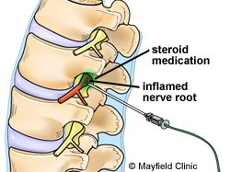
Tier #2 Steroid Injections
Transforaminal steroid injections

Slide 26
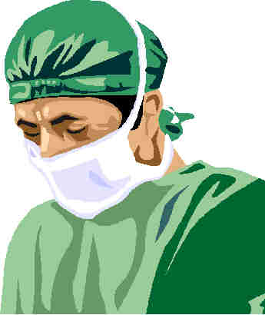
Tier #3 Surgery
Indications
Uncontrolled pain
Major or progressive muscle weakness
Radiculopathy for 4-6 weeks that has failed conservative treatment
Cauda equina
Myelopathy

Slide 27
Disc Herniations Treatment Goal
Nerve
Compression
Decompress
Treatment is for radicular symptoms, NOT neck or back pain
“A pinched nerve causes radicular symptoms, NOT neck or back pain”
Notes:
Same goes for the cervical spine

Slide 28
Diagnostic Studies
WARNING!
Do not base operative decisions ONLY on diagnostic tests
Correlate test results with the history and physical exam

Slide 29
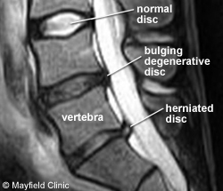
Imaging- Lumbar Spine Asymptomtic Patients
21% of patients >60 had spinal stenosis
36% of patients >60 had a degenerative or herniated disc
21% of patients 20-39 years old had a degenerative or herniated disc
Boden et al. Abnormal magnetic-resonance scans of the lumbar spine in asymptomatic subjects. A prospective investigation. The Journal of bone and joint surgery American volume (1990) vol. 72 (3) pp. 403-8
Notes:
67 patients who never had low back pain, sciatica, or neurogenic claudication.

Slide 30
Minimally Invasive Surgery (MIS) for a Disc Herniation
Notes:
In the last 20 years we have seen a significant surge in the frequency of minimally invasive surgery throughout medicine.
This is the trend is true for spine surgery as well.

Slide 31
Surgery Minimally Invasive Techniques
Advantages
Disadvantages
Less soft tissue destruction
Less blood loss
Less pain
Fewer Infections
Shorter hospitalization recovery times
Improved visualization with use of a microscope
Steep learning curve

Slide 32
Surgery Minimally Invasive Techniques
Advantages
Disadvantages
Less soft tissue destruction
Less blood loss
Less pain
Fewer Infections
Shorter hospitalization recovery times
Improved visualization with use of a microscope
Steep learning curve

Slide 33
Surgery Minimally Invasive Decompression
Nerve
Compression
Notes:
Confirmation of guidewire placement on X-ray.

Slide 34
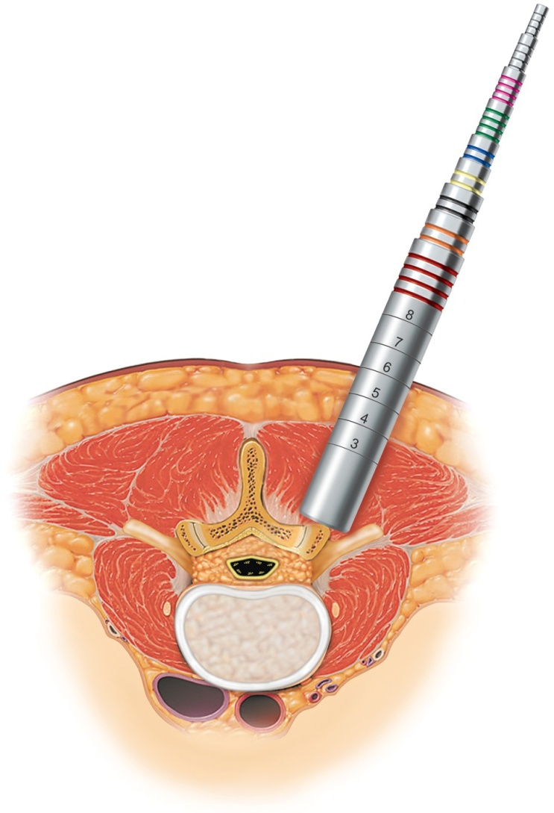
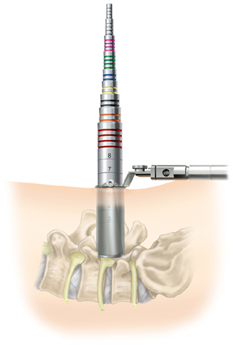
Surgery Minimally Invasive Decompression
Nerve
Compression
Notes:
The dilators and placement of tube.

Slide 35
Surgery Minimally Invasive Decompression
Nerve
Compression
Notes:
Confirm placement of tube with an X-ray.

Slide 36
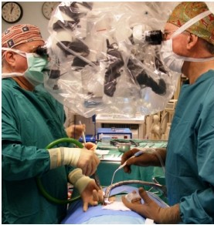
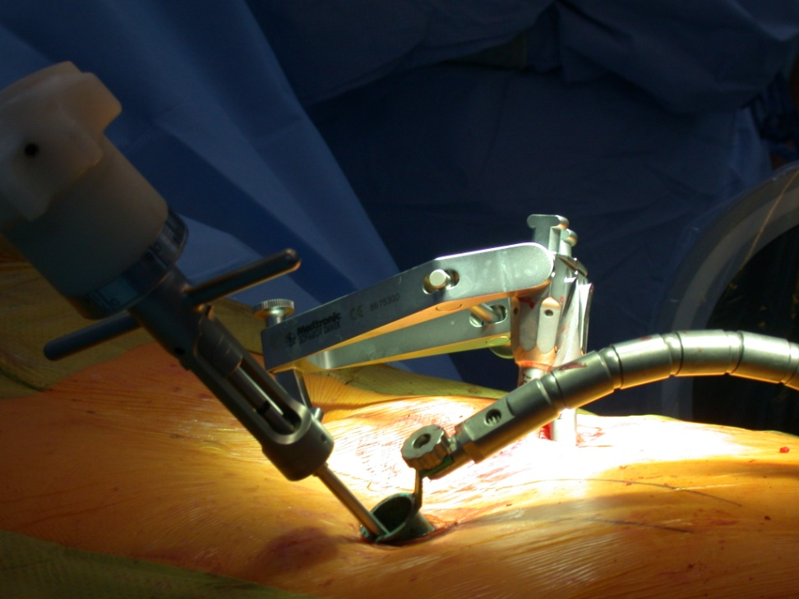
Surgery Minimally Invasive Decompression
Nerve
Compression
Notes:
Once tube is secure, use a bovie to remove any soft tissue over the bone and then use a burr to create a laminotomy.

Slide 37
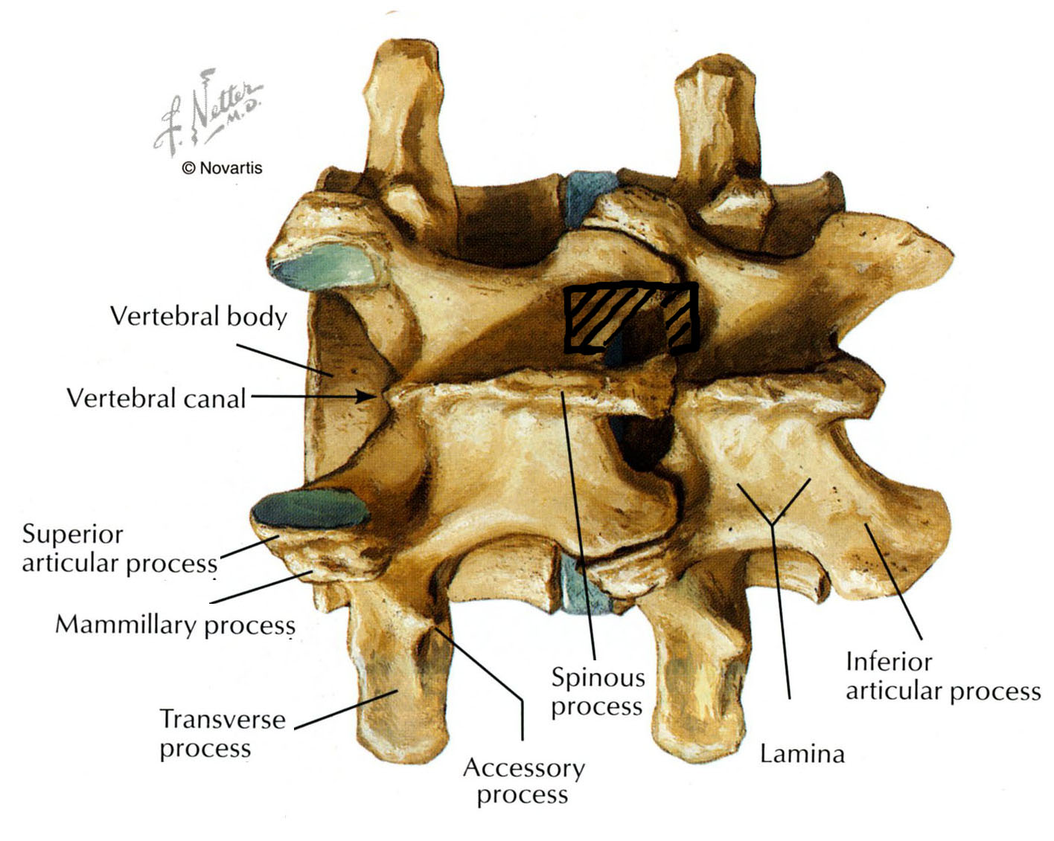
Surgery Minimally Invasive Decompression
Nerve
Compression
Laminotomy
Notes:
Pros
Limited muscle dissection
Better lighting, magnification
Shorter hospital stays, less time off of work
Cons
Increased time
Increased cost
Equipment may not be available

Slide 38
Surgery Minimally Invasive Decompression
Nerve
Compression
Notes:
Pros
Limited muscle dissection
Better lighting, magnification
Shorter hospital stays, less time off of work
Cons
Increased time
Increased cost
Equipment may not be available

Slide 39
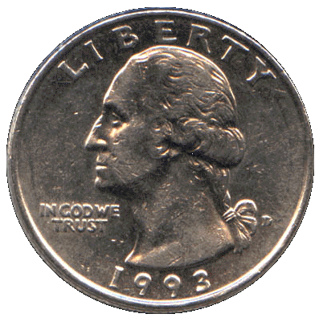
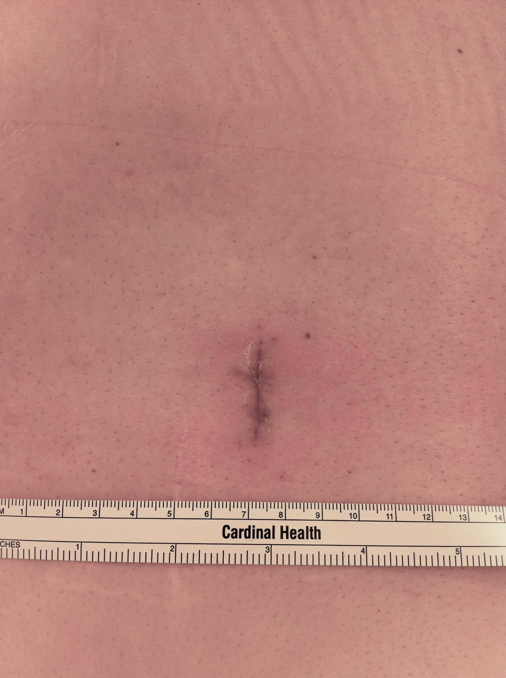
Surgery Minimally Invasive Decompression
Nerve
Compression
18 mm
Notes:
When it is all done.

Slide 40
#3 Spinal Stenosis

Slide 41
Spinal Stenosis Definition
Nerve
Compression
Stenosis (στένωσις)= “narrowing” from Ancient Greek
Narrowing of the spinal canal which can cause nerve compression.

Slide 42
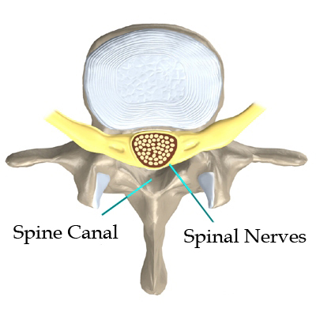
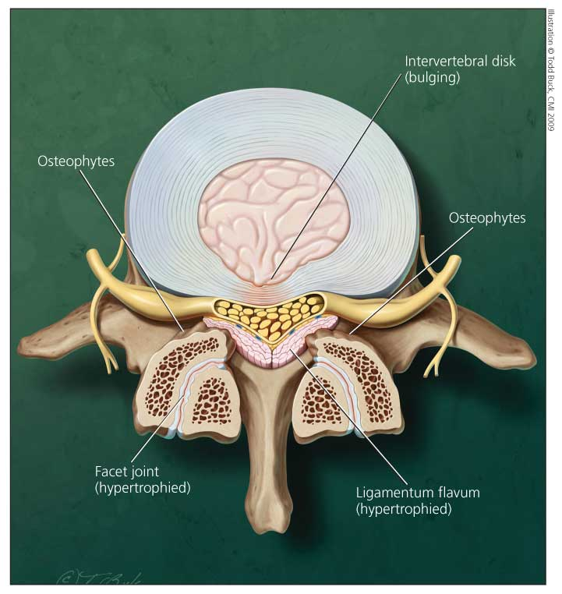
Spinal Stenosis Central vs. Foraminal
Nerve
Compression

Slide 43
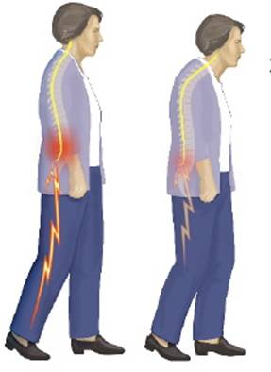
Spinal Stenosis Neurogenic Claudication
Nerve
Compression
Pain, tingling, numbness, and weakness in the buttocks and back of the legs
Heavy legs
Difficulty walking distances
Bending forward makes it better

Slide 44
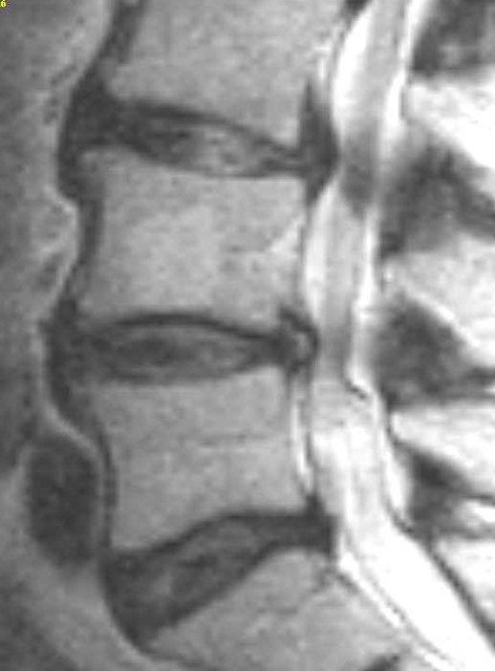
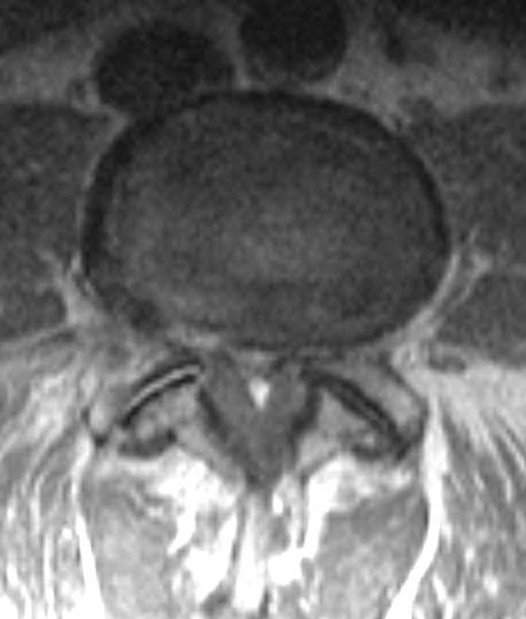
Spinal Stenosis Neurogenic Claudication
Nerve
Compression

Slide 45
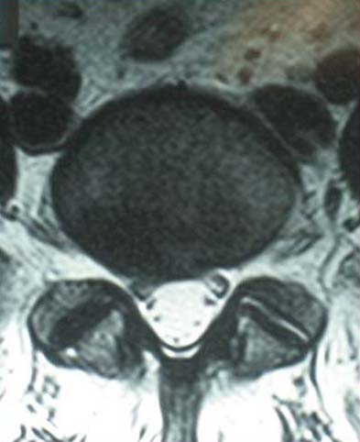
Spinal Stenosis Neurogenic Claudication
Nerve
Compression

Slide 46
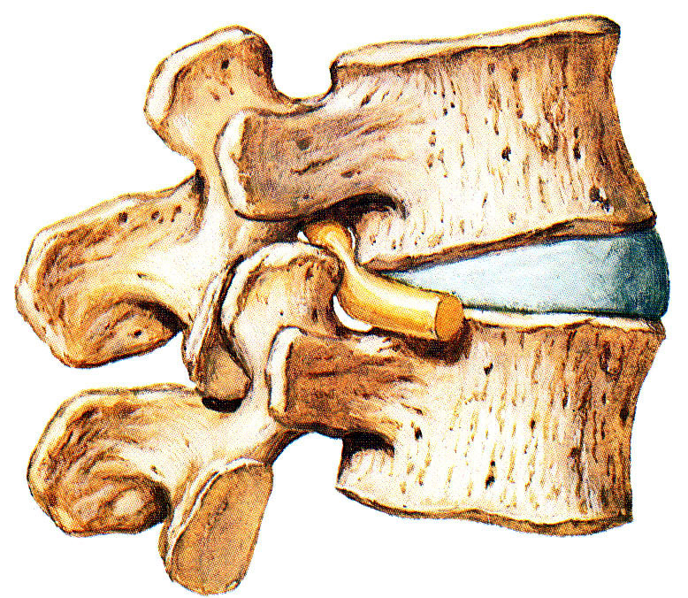
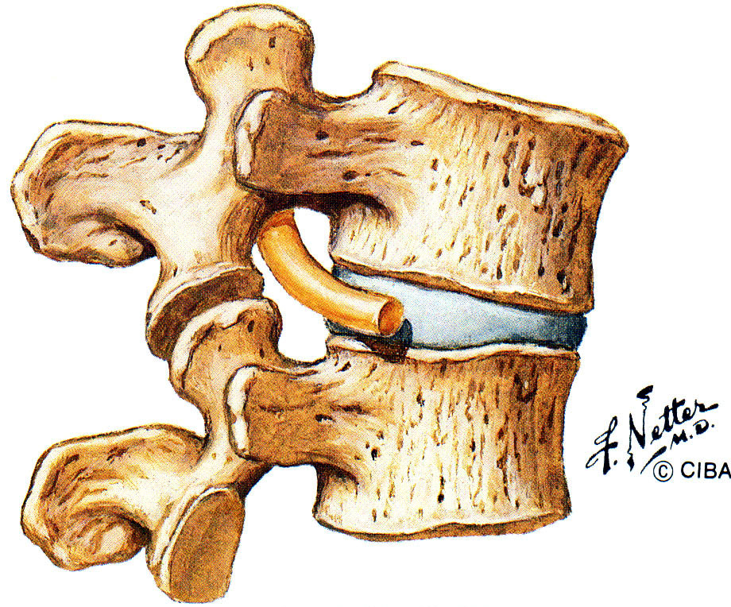
Spinal Stenosis Foraminal Stenosis
Nerve
Compression
Equivalent to standing or walking
Equivalent to sitting or bending forward

Slide 47
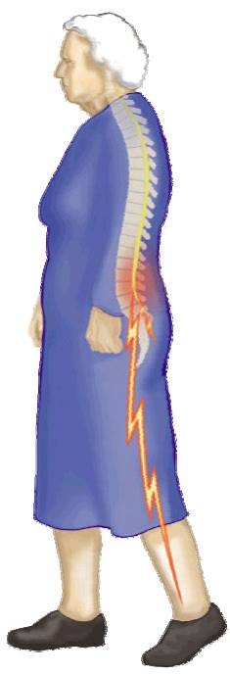
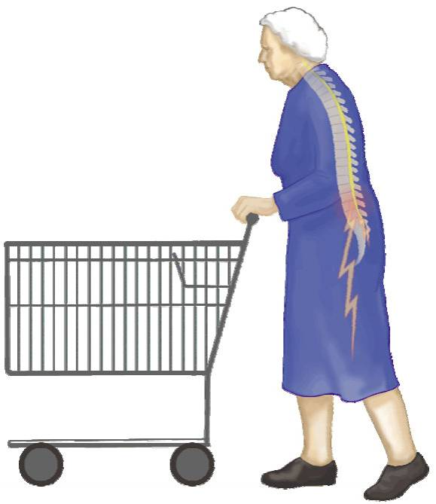
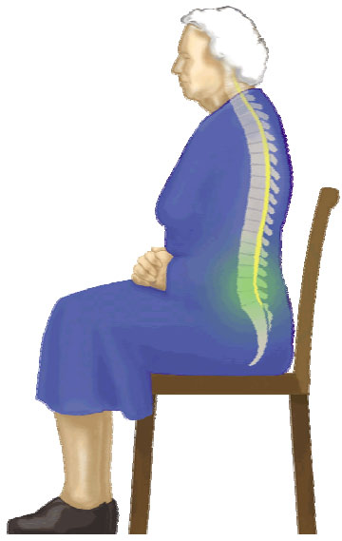
Spinal Stenosis
Nerve
Compression
Standing/ walking provoke symptoms
Leg pain
Leg weakness
“Shopping cart sign” Patients lean forward to decrease pain
Sitting relieves symptoms

Slide 48
Three Tiers of Treatment

Slide 49
Tier #1 Non-operative Treatment
Rest/activity modification
Ice/heat
NSAID’s (limit narcotics)
Muscle relaxants
Short course of oral steroids
Gabapentin
Physical therapy
Posture/ergonomics
Massage
Acupuncture
Chiropractic
Tincture of time

Slide 50
Tier #2 Steroid Injections
Steroid injections

Slide 51
Tier #3 Surgery
Indications
Uncontrolled pain
Major or progressive muscle weakness
Radiculopathy for 4-6 weeks that has failed conservative treatment
Cauda equina
Myelopathy

Slide 52
Spinal Stenosis Treatment
Nerve
Compression
Decompress
Notes:
Disks are located between the vertebral endplates covered by hyaline cartilage and supported by subchondral bone
Receive nutrients by diffusion from peripheral vascularization
Nucleus Pulposus: Type II collagen in a mucoid material, acts as a shock absorber
Anulus Fibrosis: Type I collagen in layers running in opposite directions, resists rotation, thickess anteriorly and thinnest posterolaterally
People lose height with aging due to loss of disk height

Slide 53
Operative Treatment Minimally Invasive Decompression
Nerve
Compression
18 mm
Notes:
When it is all done.

Slide 54
Operative Treatment Minimally Invasive Decompression
Nerve
Compression
Notes:
Once tube is secure, use a bovie to remove any soft tissue over the bone and then use a burr to create a laminotomy.

Slide 55
Spinal Stenosis Treatment- Central Zone
Central
Decompress
McCulloch J, Young P. Essentials of Spinal Microsurgery. Philadelphia: Lippincott-Raven, 1998.
Notes:
Bilateral decompression thru a unilateral laminotomy.
Minimizes soft tissue disruption.

Slide 56
Spinal Stenosis Treatment- Central Zone
Central
Decompress
McCulloch J, Young P. Essentials of Spinal Microsurgery. Philadelphia: Lippincott-Raven, 1998.
Notes:
A contralateral decompression can be performed using a Kerrison and curette.

Slide 57
Spinal Stenosis Treatment- Foraminal Zone
Foraminal
Decompress
Notes:
Shows a Kerrison decompressing the foramen.
Can also be used to excise the tip of the superior articular process if it is impinging on the exiting nerve.

Slide 58
#4 Spondylolisthesis

Slide 59
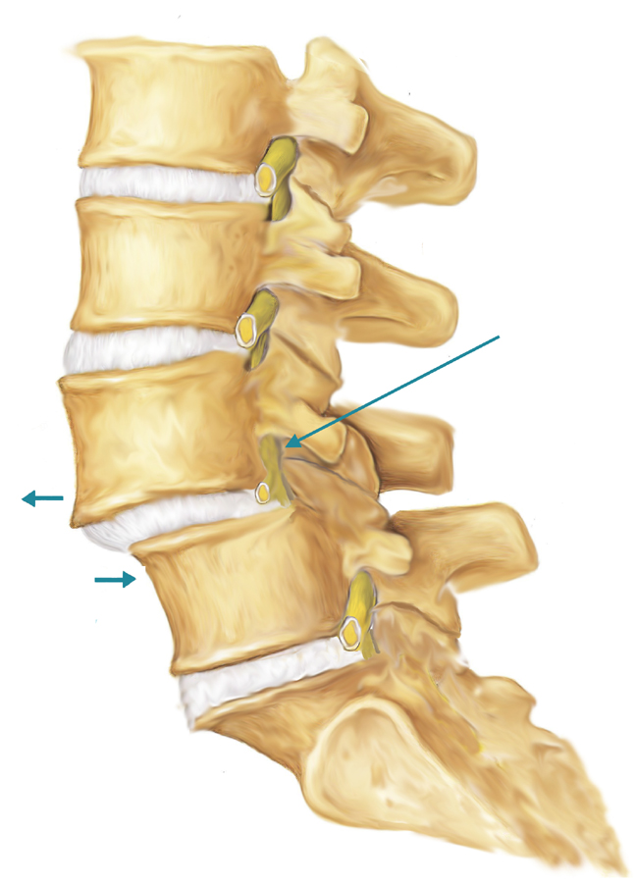
#4 Spondylolisthesis
Hyper-mobility
Nerve
Compression
Spondylo = spine
Listhesis= slippage
“The slippage of one vertebra on another”

Slide 60
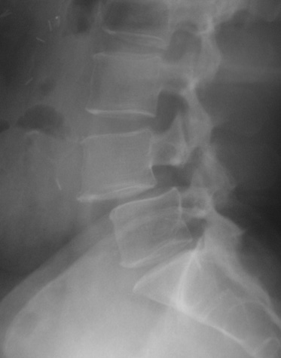
#4 Spondylolisthesis
Hyper-mobility
Nerve
Compression
Symptoms
Neck, shoulder, arm pain
Back, buttock, leg pain
Numbness, tingling, weakness or loss of reflex in arm or leg
Can be asymptomatic

Slide 61
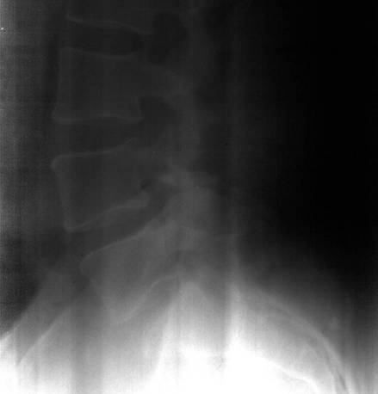
#4 Spondylolisthesis
Hyper-mobility
Nerve
Compression
Patient laying on their back
Patient Standing

Slide 62
Three Tiers of Treatment

Slide 63
Tier #1 Non-operative Treatment
Rest/activity modification
Ice/heat
NSAID’s (limit narcotics)
Muscle relaxants
Short course of oral steroids
Gabapentin
Weight loss
Physical therapy
Posture/ergonomics
Massage
Acupuncture
Chiropractic
Tincture of time

Slide 64
Tier #2 Steroid Injections
Steroid injections

Slide 65
Tier #3 Surgery
Indications
Major or progressive muscle weakness
Radiculopathy for 4-6 weeks that has failed conservative treatment
Persistent uncontrolled neck/ back pain after 6 months of conservative treatments

Slide 66
Spondylolisthesis Treatment Goals
Hyper-mobility
Stabilize
Nerve
Compression
Decompress
Notes:
Disks are located between the vertebral endplates covered by hyaline cartilage and supported by subchondral bone
Receive nutrients by diffusion from peripheral vascularization
Nucleus Pulposus: Type II collagen in a mucoid material, acts as a shock absorber
Anulus Fibrosis: Type I collagen in layers running in opposite directions, resists rotation, thickess anteriorly and thinnest posterolaterally
People lose height with aging due to loss of disk height

Slide 67
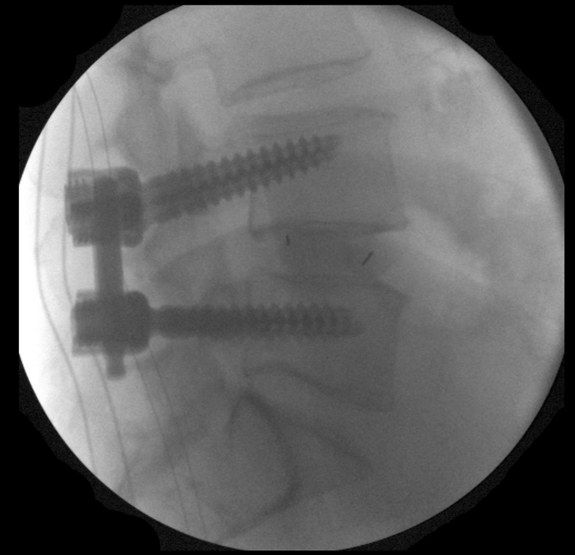
Operative Treatment Minimally Invasive Stabilization
Hyper-mobility
Notes:
Pros
Limited muscle dissection
Better lighting, magnification
Shorter hospital stays, less time off of work
Cons
Increased time
Increased cost
Equipment may not be available

Slide 68
Key Points
One MUST have a correct diagnosis: Correlate imaging studies with patient symptoms
A pinched spinal nerve causes radicular symptoms, NOT neck or back pain!!
Good indications for surgery- nerve compression, hyper-mobility, and unbalanced curves
Exhaust all non-operative treatments before considering surgery
Minimally invasive surgery offers many advantages

Slide 69
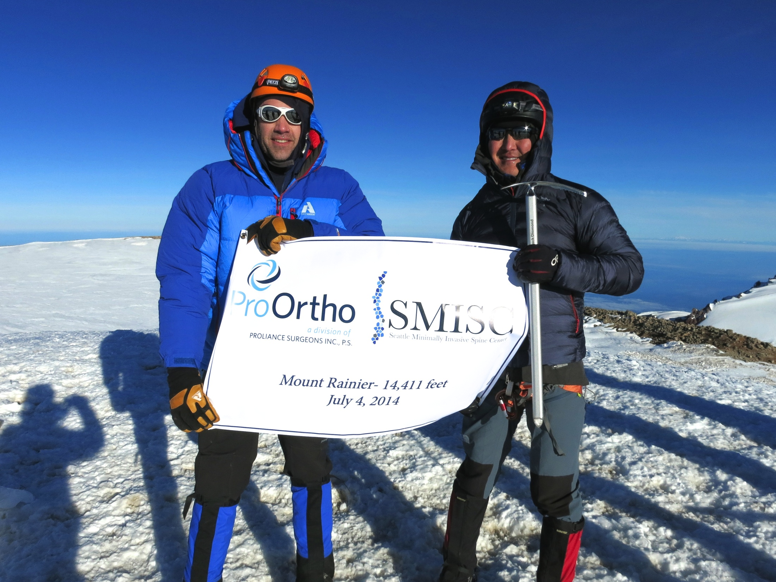
Thank You!

