Slide 1
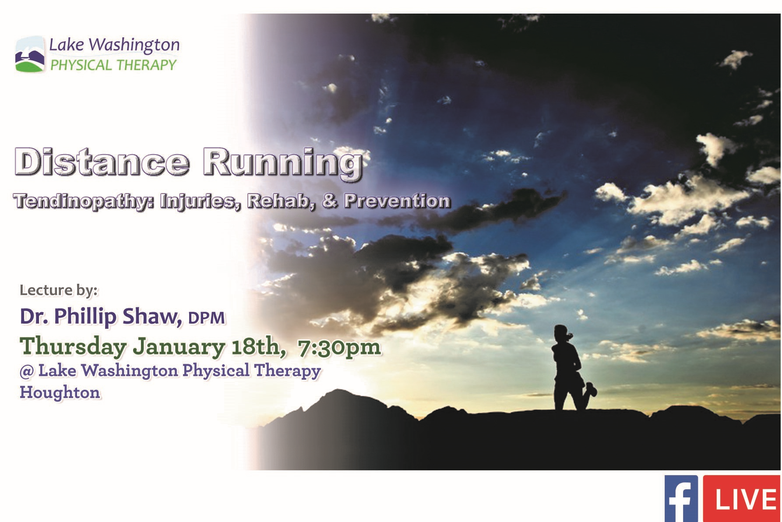

Slide 2
Tendon Injuries in Endurance Athletes
-Achilles tendinopathy
-Mid-portion
-Evidence-based
-Personally biased

Slide 3


Slide 4
“Treatments of tendinopathy that seem to be effective in poor quality studies frequently fail to show clinical benefit when assessed in good clinical studies.”
- De Vos et al., JAMA 2010

Slide 5
Spectrum of pathology
Distinct pathologies
Paratenonitis
Noninsertional Achilles tendinopathy
Insertional Achilles tendinopathy and variants
  Achilles Insertional Calcific Tendinosis (AICT)
  Haglund’s deformity
  Retrocalcaneal bursitis
Acute rupture
Chronic rupture

Slide 6
Intratendinous pathology
Histopathology: 4 key features
  Increased cell number and cellular proliferation
  Increased ground substance
  Collagen disarray
  Neovascularization
Imaging
  Ultrasound
  MRI
Primarily NOT inflammatory
Early: compensation for excessive load
Late: failed healing response
The continuum model
Normal tendon Reactive tendinopathy Disrepair Degeneration
Reactive episodes

Slide 7
Continuum model of tendinopathy
Stress shielded
Normal tendon
Reactive tendinopathy
Tendon disrepair
Degenerative tendinopathy
Unloaded
Optimized load
Optimized load
Adaptation
Strengthen
Excessive load +/- individual factors
Appropriate modified load
Adapted from Cook JL and Purdam CR, Br J Sports Med 2009

Slide 8
Why does it hurt?
Normal tendon
Reactive tendinopathy
Tendon disrepair
Degenerative tendinopathy
Overall weak association between pain and extent of pathology
Reactive tendinopathy
  Increased pain-associated neurotransmitters/receptors
  Neurogenic inflammation
Tendon disrepair and degenerative tendinopathy
  Neovascularization associated with innervation and neurotransmitters
  Concentrated neurotransmitters near and in vessel wall
  Sclerosing therapy effective at pain reduction
Neovascularization

Slide 9
Rationale for treatment
Triad of swelling, pain, dysfunction
Normalize tendon anatomy
  Appropriate cyclic loading – mechanotherapy
  Simulate acute injury
    ESWT
    Surgical
    Target biochemical mediators of tendon healing
  Direct surgical remodeling
Decrease Pain
  Immobilization, complete or relative rest
  Target neovascularization
    Mechanotherapy
    Sclerosing therapy
    Surgical
Increase function
  Mechanotherapy

Slide 10
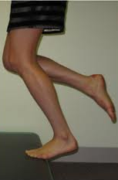
Eccentric training
Increases type 1 collagen without reactive changes
Decreases neovascularization
Multiple level 1 RCTs supporting use for short and long term resolution of mid-portion tendinopathy
  Improves pain
    Mean pain reduction 60%
  Improves function
    Strength comparable to contralateral limb
  Improves tendon structure/thickness
    70% normal structure at 3.8 years, nearly all remaining abnormal tendons asymptomatic
  High patient satisfaction
    >80%, maintained long term
  Can be supplemented with additional therapies
    Many may show no additional benefit (NSAIDs, rest, night splint)

Slide 11
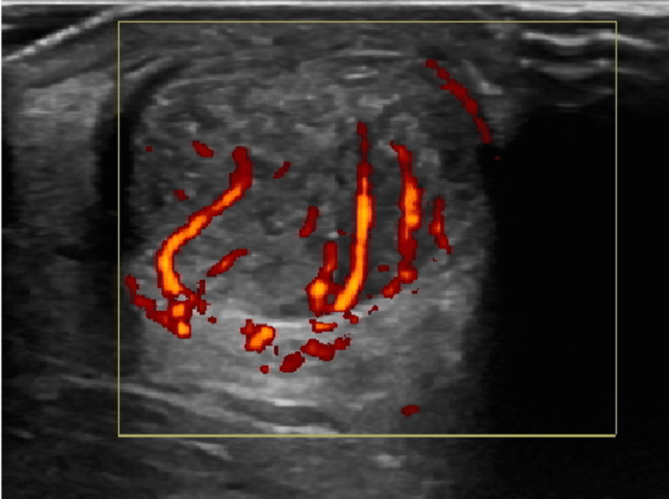
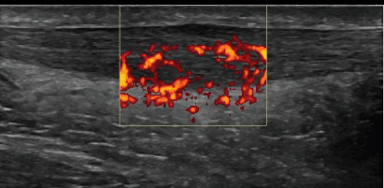
Sclerosing therapy
Explicitly targets neovascularization with polidocanol
Pilot study 2002, since supported by multiple RCTs
  Alfredson et al. 2005
    9/10 in treatment group, crossover yields 10/10
  Lind et al. 2006
    After 3 injections, 37/42 satisfied, back to preinjury activity level
    At 2 years, tendon thickness improved, pain reduction maintained (VAS 75→7), 38/42 satisfied
  Willberg et al. 2008
    After 2-3 injections, 18/26 satisfied with pain reduction
    Additional injections (up to 5) yielded 26/26 satisfied
Viable minimally invasive treatment option

Slide 12
Extracorporeal Shock Wave Therapy
Al-Abbad H and Simon JV. Foot Ankle Int 2013.
  Systematic meta-analysis of 6 RCTs
    Some treatment variability
    1500-2500 impulses, energy flux density 0.08-0.5 mJ/mm²
    Average of 3 weekly treatments
    Significant reduction in pain and functional improvement
  Satisfactory evidence for ESWT alone, but improves when combined with eccentric training.
Mani-Babu et al. Am J Sports Med 2015.
  Level 1 meta-analysis, 13 trials.
    Superior results compared to eccentric training for insertional tendinopathy.
    Moderate support for ESWT alone for midportion tendinopathy.
    Superior outcomes when combined with eccentric training for midportion tendinopathy.

Slide 13
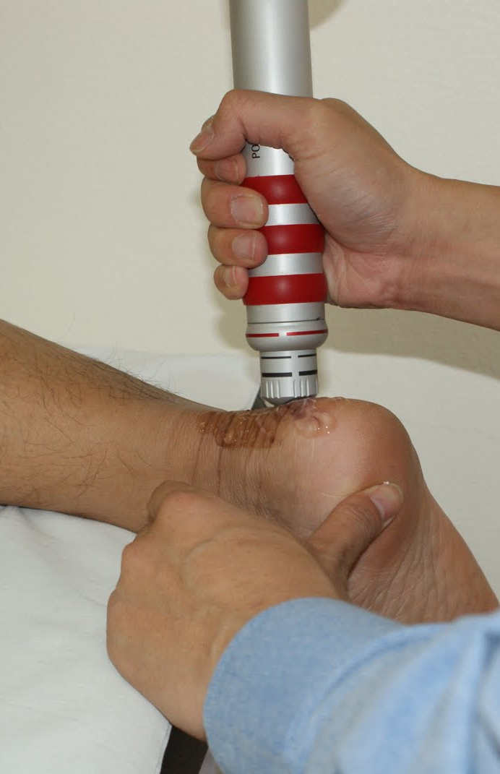
ESWT
Non-insertional Achilles tendinopathy
  Rompe et al. JBJS 2008. Level 1.
    Eccentric exercise: 56% reported complete recovery at 4 months
    Shockwave plus EE: 82% complete recovery at 4 months
    No difference at 1 year
Insertional Achilles tendinopathy
  Rompe et al. Am J Sports Med 2009. Level I.
    Eccentric exercise: 28 % complete recovery at 4 months.
    Shockwave plus EE: 64% complete recovery at 4 months.
    Results stable at 1 year

Slide 14
Other options?
Corticosteroid injection
  Coombes et al. Lancet 2010. Significant pain reduction short term only. Poor long term results. Risk of rupture not substantiated by RCTs.
  Speed, BMJ 2001. Insufficient evidence to support use.
  Shrier et al., Clin J Sports Med. 1996. Only level 1 study showed no benefit of corticosteroid. Risk of weakness/rupture supported only by animal models and case reports.
Platelet-Rich Plasma (PRP)
  De Vos et al., JAMA 2011: Level I study of PRP injections in chronic midsubstance tendinopathy. No difference compared to saline injection at 24 months. Eccentric stretching in both groups.
  De Jonge et al., Am J Sports Med 2011. Level 1 study. One year followup. No significant difference between groups. 59% satisfied with treatment. Ultrasonographic improvement in both groups.
Aprotonin
  Brown et al. Br J Sports Med 2006, no short or long term benefit
Topical glyceral trinitrate
  Paoloni et al. JBJS 2004. Topical glyceryl trinitrate plus eccentric training. 78% asymptomatic versus 49% in control group.

Slide 15
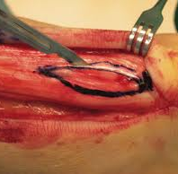
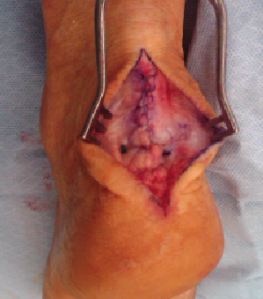

Surgical treatment
Targets regions of degenerative tendinopathy
No consensus on technique, but results are consistent.
Successful return to sports in 50-80%, but all based on level IV evidence
Better outcomes in athletic versus sedentary patients
Must be followed with appropriate rehabilitation
  Treat “the donut”
N
Normal or reactive tendon
Degenerative tendon

Slide 16
Typical treatment paradigm
Rest/immobilization
    Relative rest
    Relative immobilization
    Strict immobilization
Address “inflammation”
Physical therapy
  Eccentric strengthening
  Adjuncts (soft tissue mobilization, ultrasound, etc)
Frustrated flail
Surgical debridement
“Treatments of tendinopathy that seem to be effective in poor quality studies frequently fail to show clinical benefit when assessed in good clinical studies.” De Vos, JAMA 2010

Slide 17
What should a clinician do?
Proposed evidence-base protocol
Upon presentation with mid-portion tendinopathy
  Address obvious training error
  12 weeks of eccentric training
  Continue pain-moderated activity in athletes (pain <5/10)
If responding or resolved
Continue maintenance eccentric training 6-12 months
If not responding
Consider topical GTN (low risk), continue eccentric training x 12 weeks
ESWT and eccentric training x 12 weeks
Sclerosant x 3 (6 months total)
Surgical debridement, rehabilitation
Continue maintenance eccentric training
Adapted from Alfredson and Cook Br J Sports Med 2007

Slide 18


Slide 19
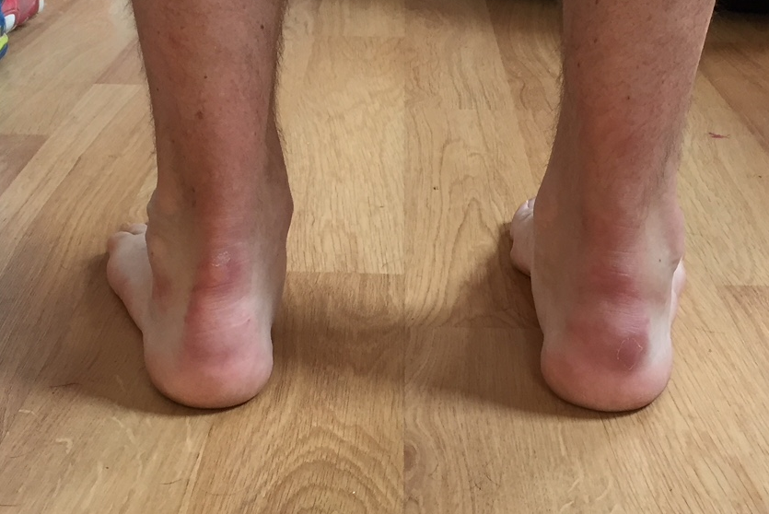

A pragmatic approach
My own experience
New solutions or directions?
Resistance to evidence-based medicine
  Biases
  Patient demographics
  Patient compliance
  Personal preferences and experiences

Slide 20
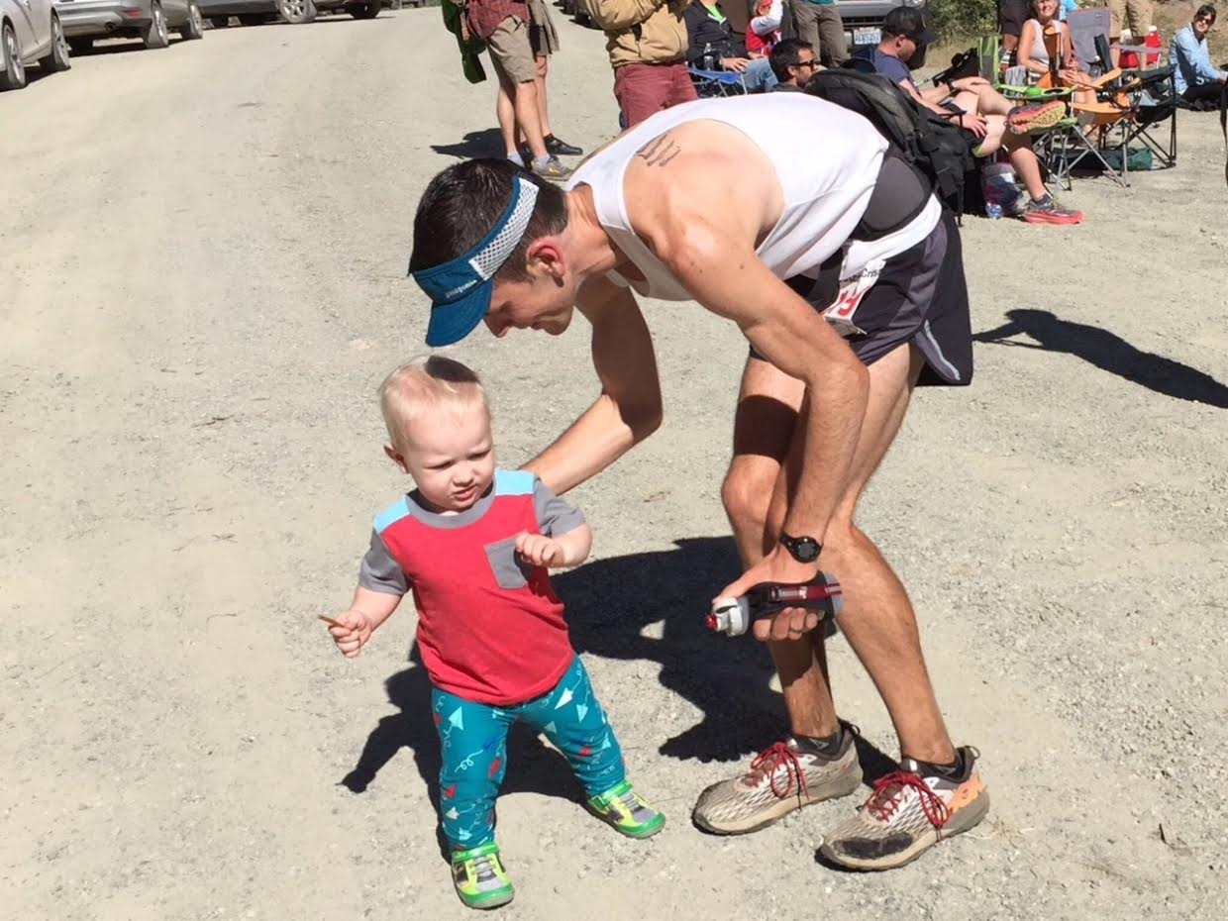
Phil Shaw DPM
Phil.A.Shaw@gmail.com

Slide 21
References
Alfredson H. 2011. Ultrasound and Doppler-guided minisurgery to treat midportion Achilles tendinosis: results of a large material and randomized study comparing two scraping techniques. Br J Sports Med 45 (5): 407-10.
Alfredson H and Cook J. 2007. A treatment algorithm for managing Achilles tendinopathy: new treatment options. Br J Sports Med 41 (4): 211-216.
Alfredson and Ohberg. 2006. Increased intratendinous vascularity in the early period after sclerosing injection treatment in Achilles tendinosis: a healing response? Knee Surg Sports Traumatol Arthrosc. 14:399 – 401.
Astrom M and Westlin N. No effect of piroxicam on Achilles tendinopathy. A randomized study of 70 patients. Acta Orthop Scand 1992; 63: 631-4.
Bouche and McInnes. 2005. “Posterior heel pain: Haglund’s deformity, pump bump deformity, and Achilles insertional calcific tendinosis (AICT)” in Master Techniques in Podiatric Surgery: Foot and Ankle, Chang, ed. Lippincott Williams and Wilkins, NY, 265-277.
Carcia et al. Achilles pain, stiffness, and muscle power deficits: Achilles tendonitis. Clinical practice guidelines linked to the international classification of functioning, disability, and health from the orhopaedic section of the American physical therapy association. J Ortho Sports Phys Ther 2010: 40 (9), A1-A26.
Cook JL and Purdam CR. Is tendon pathology a continuum? A pathology model to explain the clinical presentation of load induced tendinopathy. Br J Sports Med 43: 409-16.
Cook et al. 2016. Revisiting the continuum model of tendon pathology: what is its merit in clinical practice and research? Br J Sports Med 50: 1187-1191.
Coombes et al. 2010. Efficacy and safety of corticosteroid injections and other injections for management of tendinopathy: a systematic review of randomized controlled trials. Lancet 376:1751-69.
De Jonge et al. 2011. One-year followup of platelet-rich plasma treatment in chronic Achilles tendinopathy: a double blind randomized placebo controlled trial. Am J Sports Med 39: 1623.
De Jonge et al. 2015. The tendon structure returns to asymptomatic values in nonoperatively treated Achilles tendinopathy but is not associated with symptoms: a prospective study. Am J Sports Med 43 (12): 2950-8.
Del Buono et al. 2013. Platelet-rich plasma: anatomical application to date: does it really work: Operative techniques in orthopaedics 23 (2): 75-77.
De Vos et al. 2010. Platelet-rich plasma injection for chronic Achilles tendinopathy: a randomized controlled trial. JAMA 303(2): 144-150
De Vos et al. 2011. No effects of PRP on ultrasonographic tendon structure and neovascularization in chronic midportion Achilles tendinopathy. Br J Sports Med 45 (5): 387-92.
Fahlstrom et al. 2003. Chronic Achilles tendon pain treated with eccentric calf-muscle training. Knee Surg Sports Traum Arthrosc 11:327-33.
Irwin. 2010. Current concepts review: insertional Achilles tendinopathy. Foot Ankle Int 31 (10): 934-40
Jonsson et al. 2008. New regimen for eccentric calf-muscle training in patients with chronic insertional Achilles tendinopathy: results of a pilot study. Br J Sports Med 42:746-9.

Slide 22
References, continued
Krogh et al. 2016. Ultrasound-guided injection therapy of Achilles tendinopathy with platelet-rich-plasma or saline: a randomized, blinded, placebo-controlled trial. Am J Sports Med 44 (8): 1990-7
Mafi et al. 2001. Superior short-term results with eccentric calf muscle training compared to concentric training in a randomized prospective multicenter study on patients with chronic Achilles tendinosis.Knee Surg Sports Traumatol Arthrosc 9: 42-47.
Mani-Babu et al. 2015. The effectiveness of extracorporeal shock wave therapy in lower limb tendinopathy: a systematic review. Am J Sports Med 43 (3): 752-61.
McCormack JR et al. 2016. Eccentric exercise versus eccentric and soft tissue treatment (Astym) in the management of insertional Achilles tendinopathy: a randomized controlled trial. Sports Health epub ahead of print.
Munteanu and Barton. 2011. Lower limb biomechanics during running in individuals with Achilles tendinopathy: a systematic review. J Foot Ankle Res 4:15.
Murray et al. 2005. How evidence based is the management of two common sports injuries in a sports injury clinic? Br J Sports Med 39: 912-916.
Paoloni et al. 2004. Topical glyceryl trinitrate treatment of chronic noninsertional Achilles tendinopathy: a randomized, double blind, placebo controlled trial. JBJS 86 (5): 916-923.
Rompe et al. 2007. Eccentric loading, shockwave treatment or a wait-and-see policy for tendinopathy of main body of teno-Achilles.: a randomized controlled trial. Am J Sports Med 35(3): 374-383.
Rompe et al. 2008. Eccentric loading compared with shock-wave treatment for chronic insertional Achilles tendinopathy: a randomized, controlled trial. JBJS 90: 52-61.
Rompe et al. 2009. Eccentric loading versus eccentric loading plus shock-wave treatment for mid-portion Achilles tendinopathy. Am J Sports Med 37(3): 463-471.
Rowe et al. 2012. Conservative management of midportion Achilles tendinopathy: a mixed methods study, integrating systematic review and clinical reasoning. Sports Med 42(11): 941-67.
Shrier et al. 1996. Achilles tendonitis: are corticosteroid injections useful or harmful? Clin J Sports Med 6: 245-250.
Silbernagel et al. 2007. Continued sports activity, using a pain monitoring model, during rehabilitation in patients with Achilles tendinopathy. Am J Sports Med 35(6)
Speed. 2001. Corticosteroid injections in tendon lesions. BMJ 323:382-387.
Steinert et al. 2012. Platelet-rich plasma in orthopedic surgery and sports medicine: pearls, pitfalls, and new trends in research. Operative Techniques in Orthopaedics 22 (2): 91-103
Van Sterkenburg and van Dijk. 2011. Mid-portion Achilles tendinopathy: why painful? An evidence based philosophy. Knee Surg Sports traumatol Arthrosc 19: 1367-1375.
Verrall et al. 2011. Chronic Achilles tendinopathy treated with eccentric stretching program. Foot Ankle Int 32(9): 843-849.
Woodley et al. 2007. Chronic tendinopathy: effectiveness of eccentric exercise. Br J Sports Med 41: 188-199.
Xan et al. 2009. Current concepts review: noninsertional Achilles tendinopathy. Foot Ankle Int 30 (11): 1132-43

